Slide 1
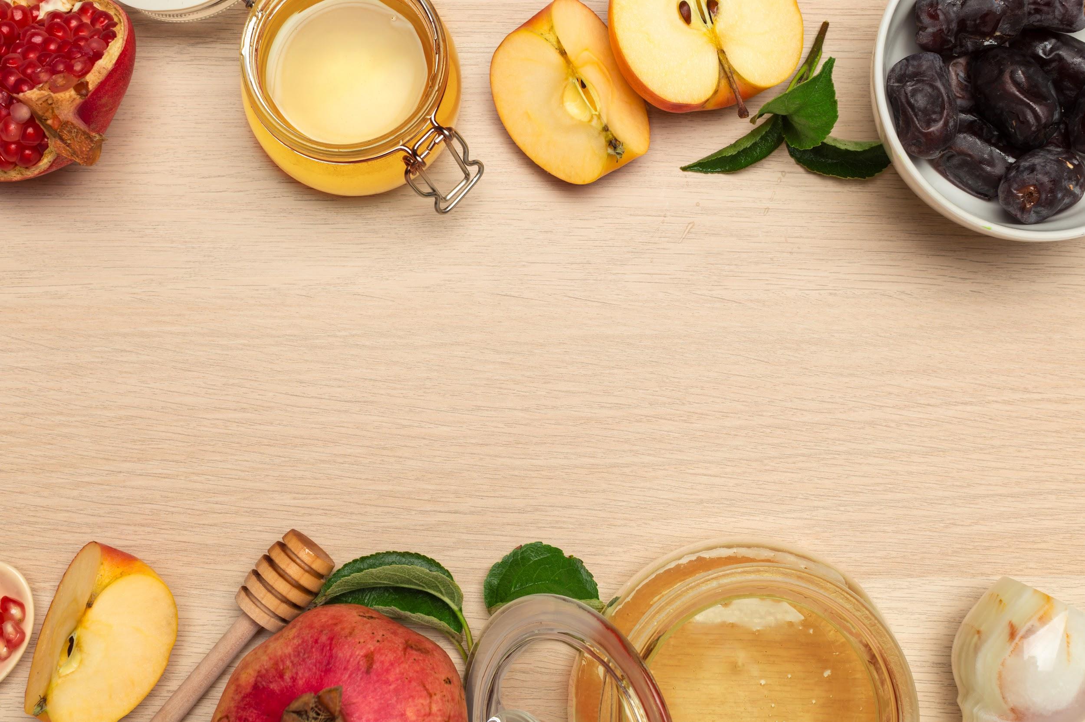
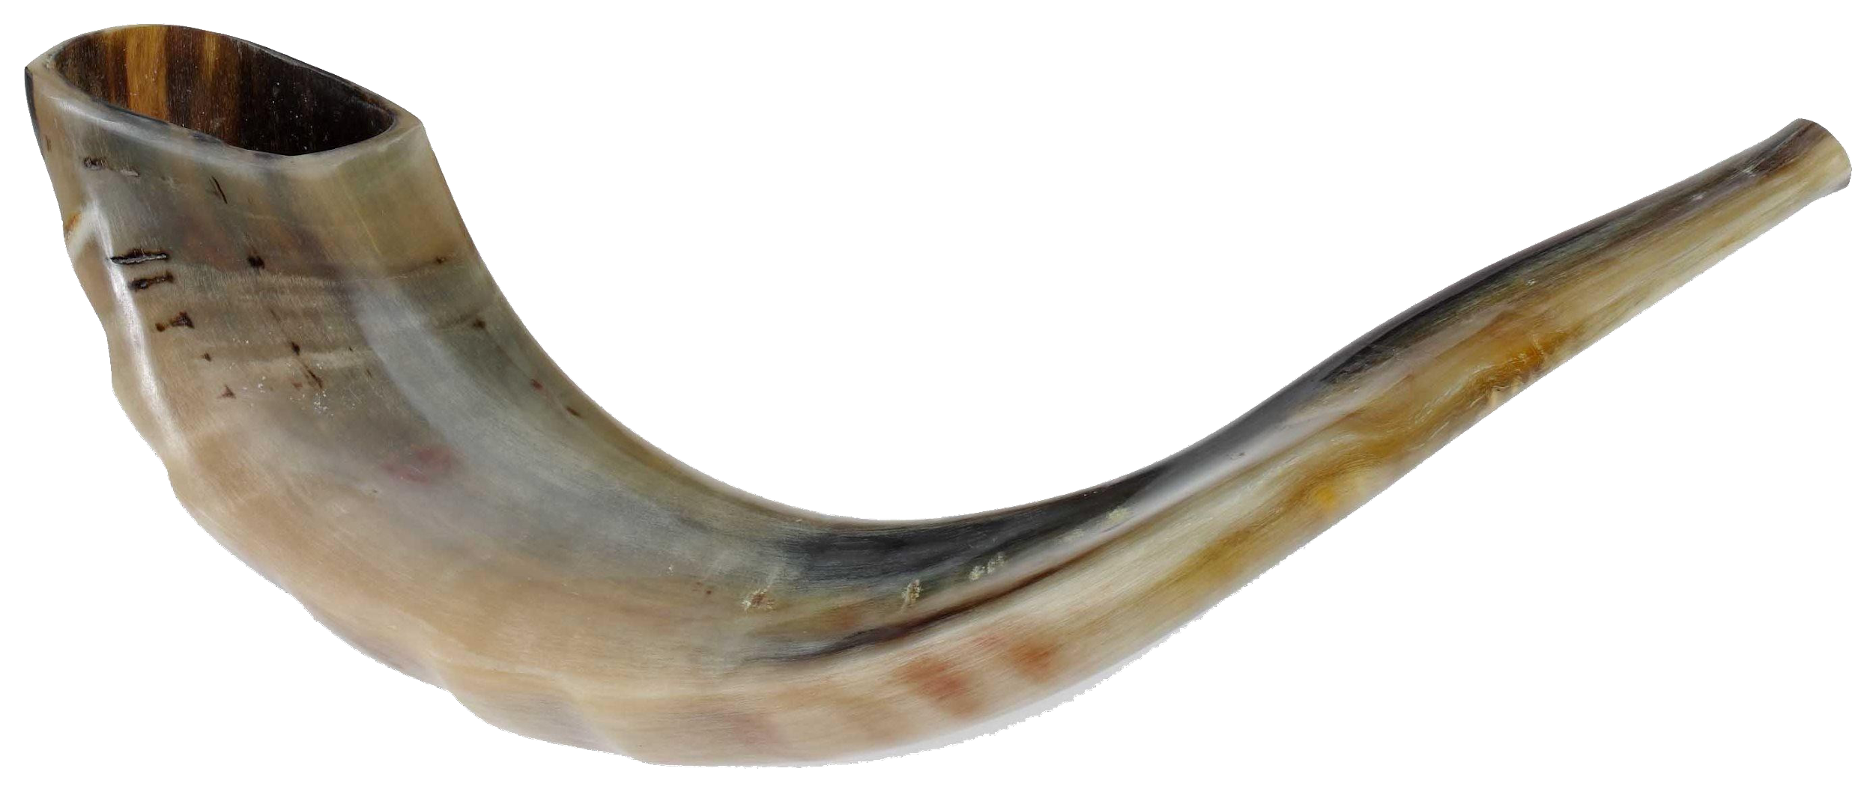
Rosh Hashanah
The Jewish New Year
בס’’ד
Yaldei
Notes:
Welcome to all about Rosh Hashana!

Slide 2
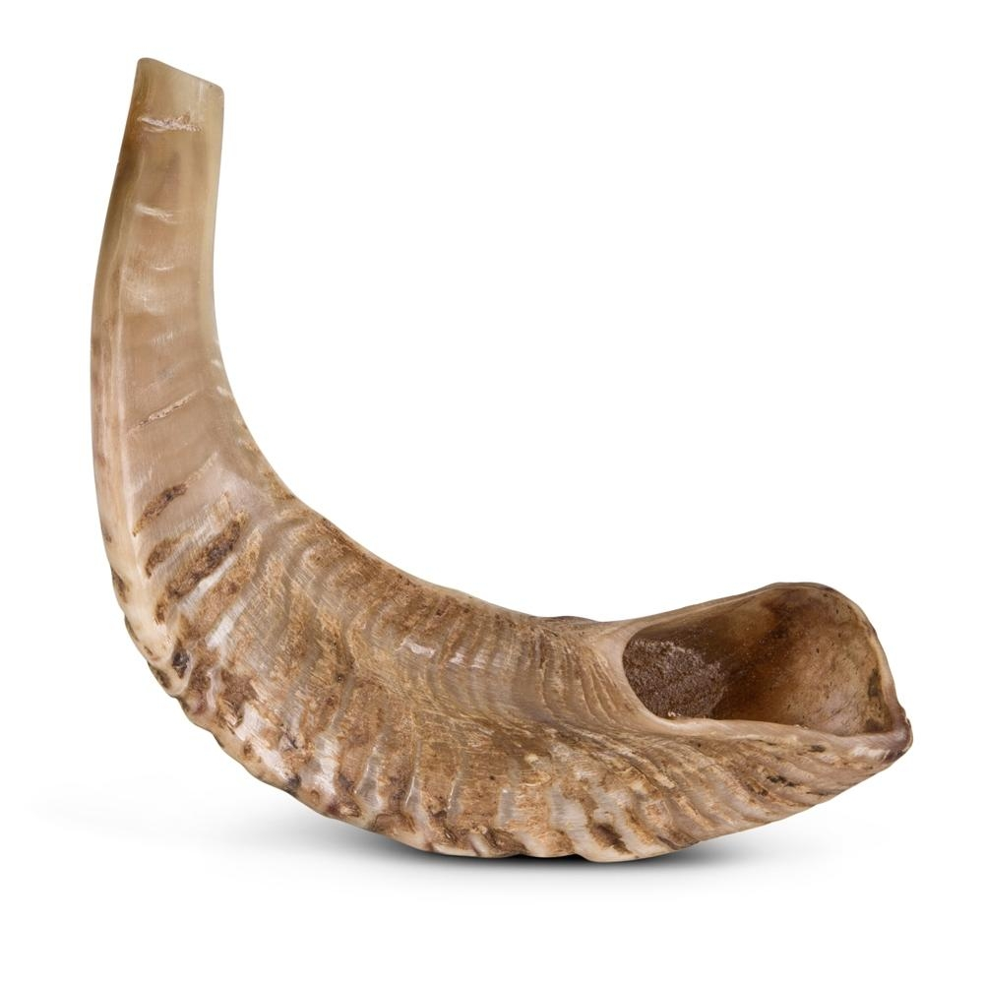
What we will learn about:
01
03
02
04
Why we have Rosh Hashana
Rosh Hashanah Foods
The first Rosh Hashanah Was when Hashem created Man. Hashem is King of the whole world.
Discover the special foods of Rosh Hashanah.
A Niggun
The Shofar
Announce Hashem is King with a kosher shofar! What are the three sounds of the shofar?
Let’s daven to Hashem, our Tatti, our King. On Rosh Hashana we sing about how awesome is Hashem. He is our Father, and our King.

Slide 3
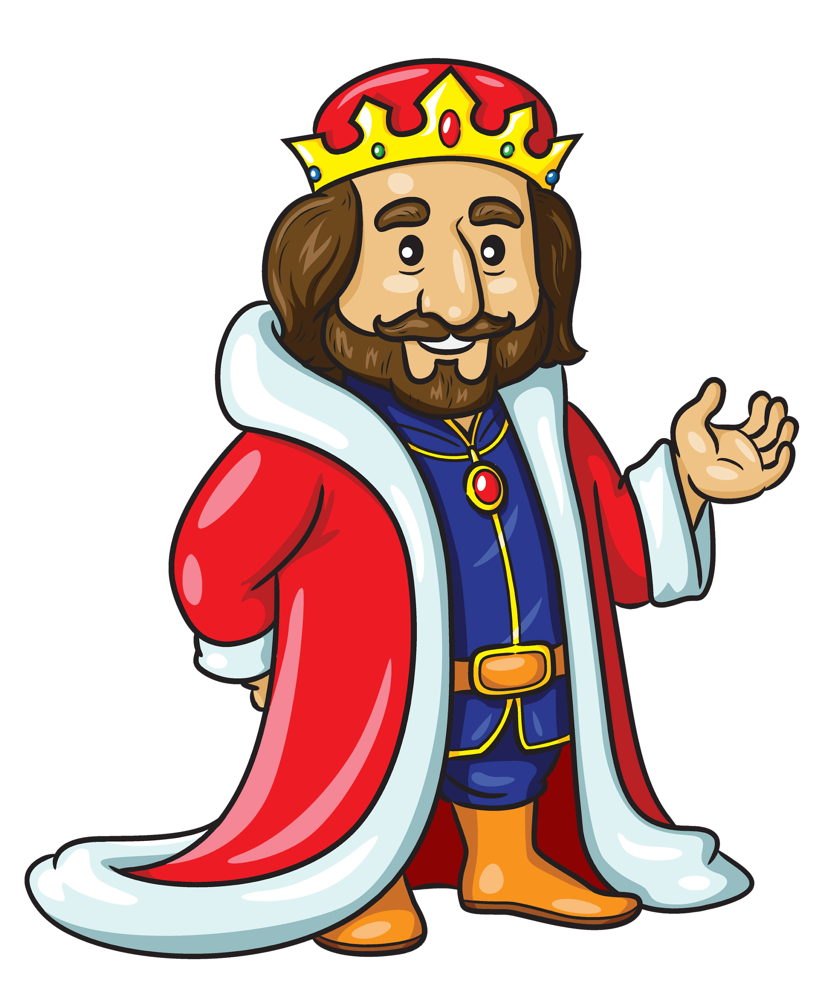
Why do we have Rosh Hashana?

Slide 5
Why do we have Rosh Hashana?

Slide 6
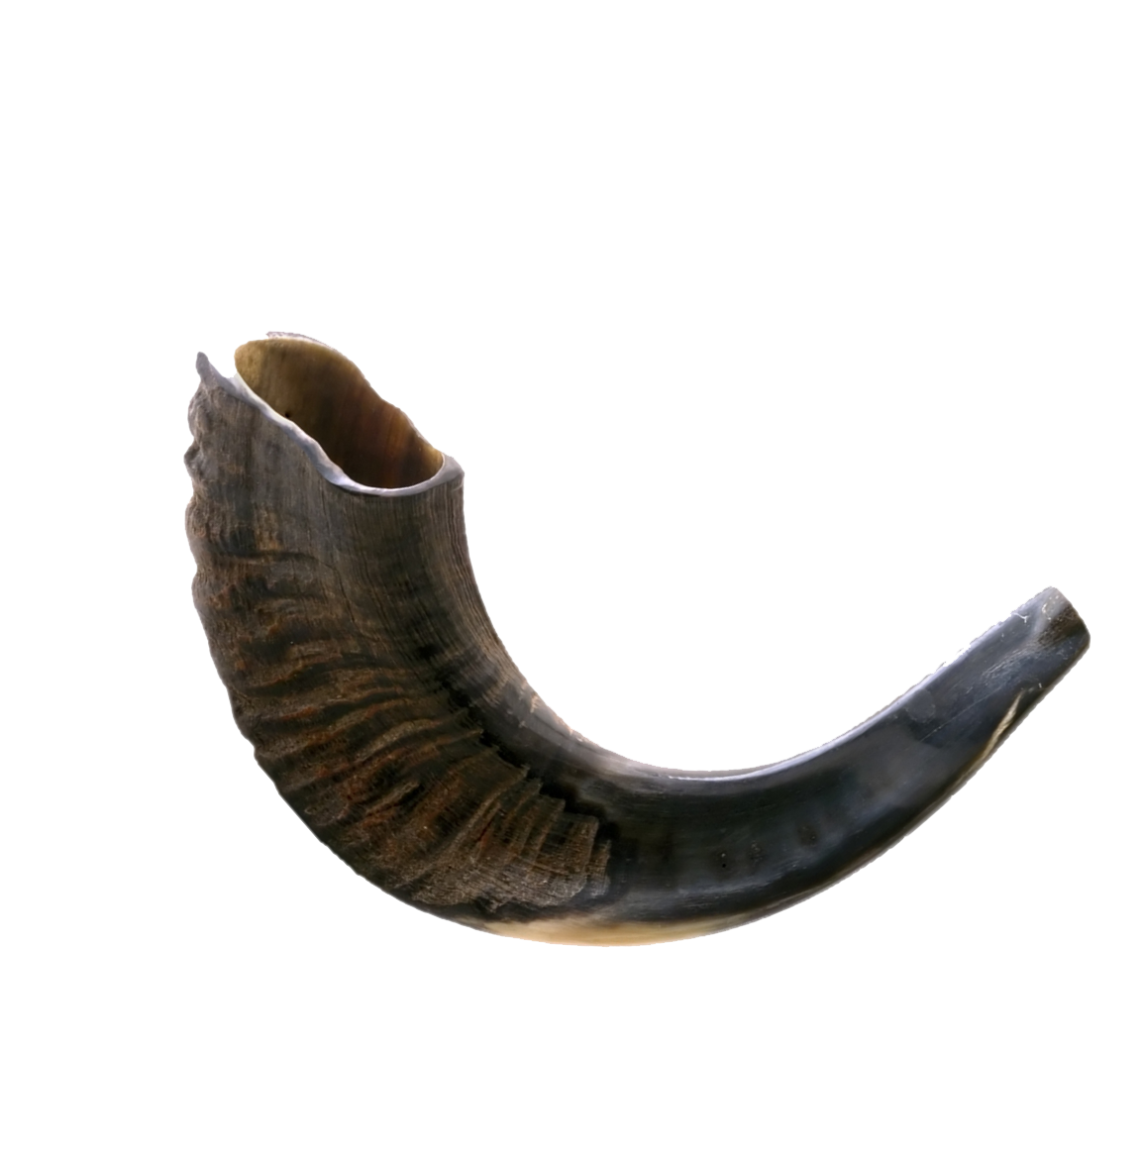
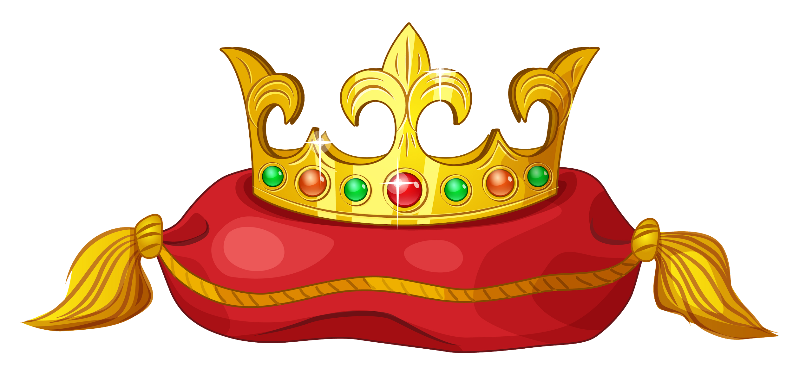
Why the Shofar?
To crown Hashem as King

Slide 7
Why the Shofar?
To remind us to do Teshuvah, to become closer and love Hashem.

Slide 8
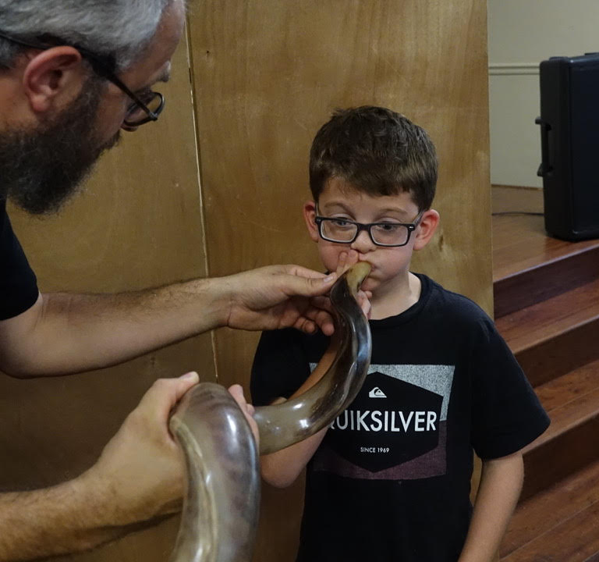
The Shofar
What does it sound like?
When blowing the shofar we use three sets of blasts. Each set is different from the other. The various notes of the shofar that are blown are:
Teki’ah – one long blast
Shevarim – three broken sounds
Teru’ah – nine very short sounds.

Slide 9
The Shofar
One Long Blast
Teki’ah
Three Medium Blasts
Shevarim
Nine Small Blasts
Teru’ah
What is the name of the last sound we hear from the Shofar?
Tekiah Gedolah (The Big Tekiah)

Slide 10
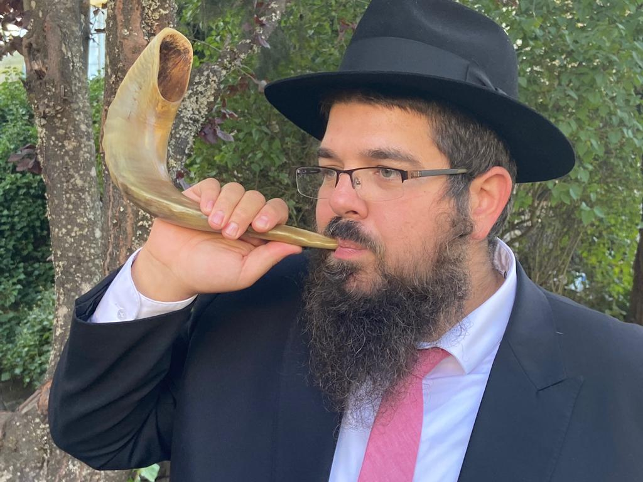
Shofar for Everyone!
On Rosh Hashana we blow the shofar for as many yidden as we can! The Rebbe wants every Jew to listen to the shofar!
It’s such a big mitzva to listen to the shofar!

Slide 11
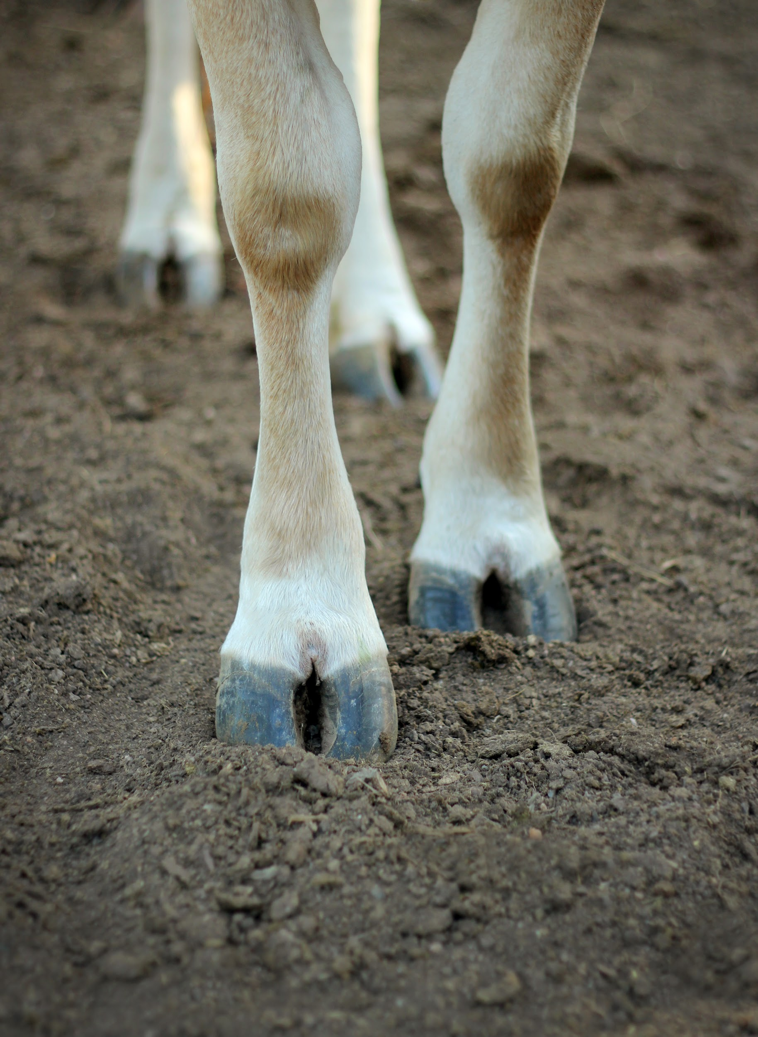
Can I get a Shofar from anywhere?
Q. Was the animal Kosher?
Did the animal chew its cud and have split hooves?
Split Hooves

Slide 12
What about the Horns?
Q. Is the horn curved & hollow?
The horn must have a curve.
It also must be naturally hollow

Slide 13
The Machzor
We use a special siddur called a machzor on Rosh Hashana.
We ask Hashem for a sweet new year.
What would you ask for?

Slide 14
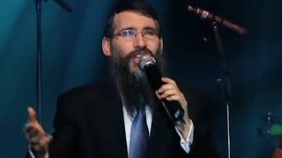
Avinu Malkeinu
- Our Father, Our King

Slide 15
What special foods do we eat for Rosh Hashana?

Slide 16
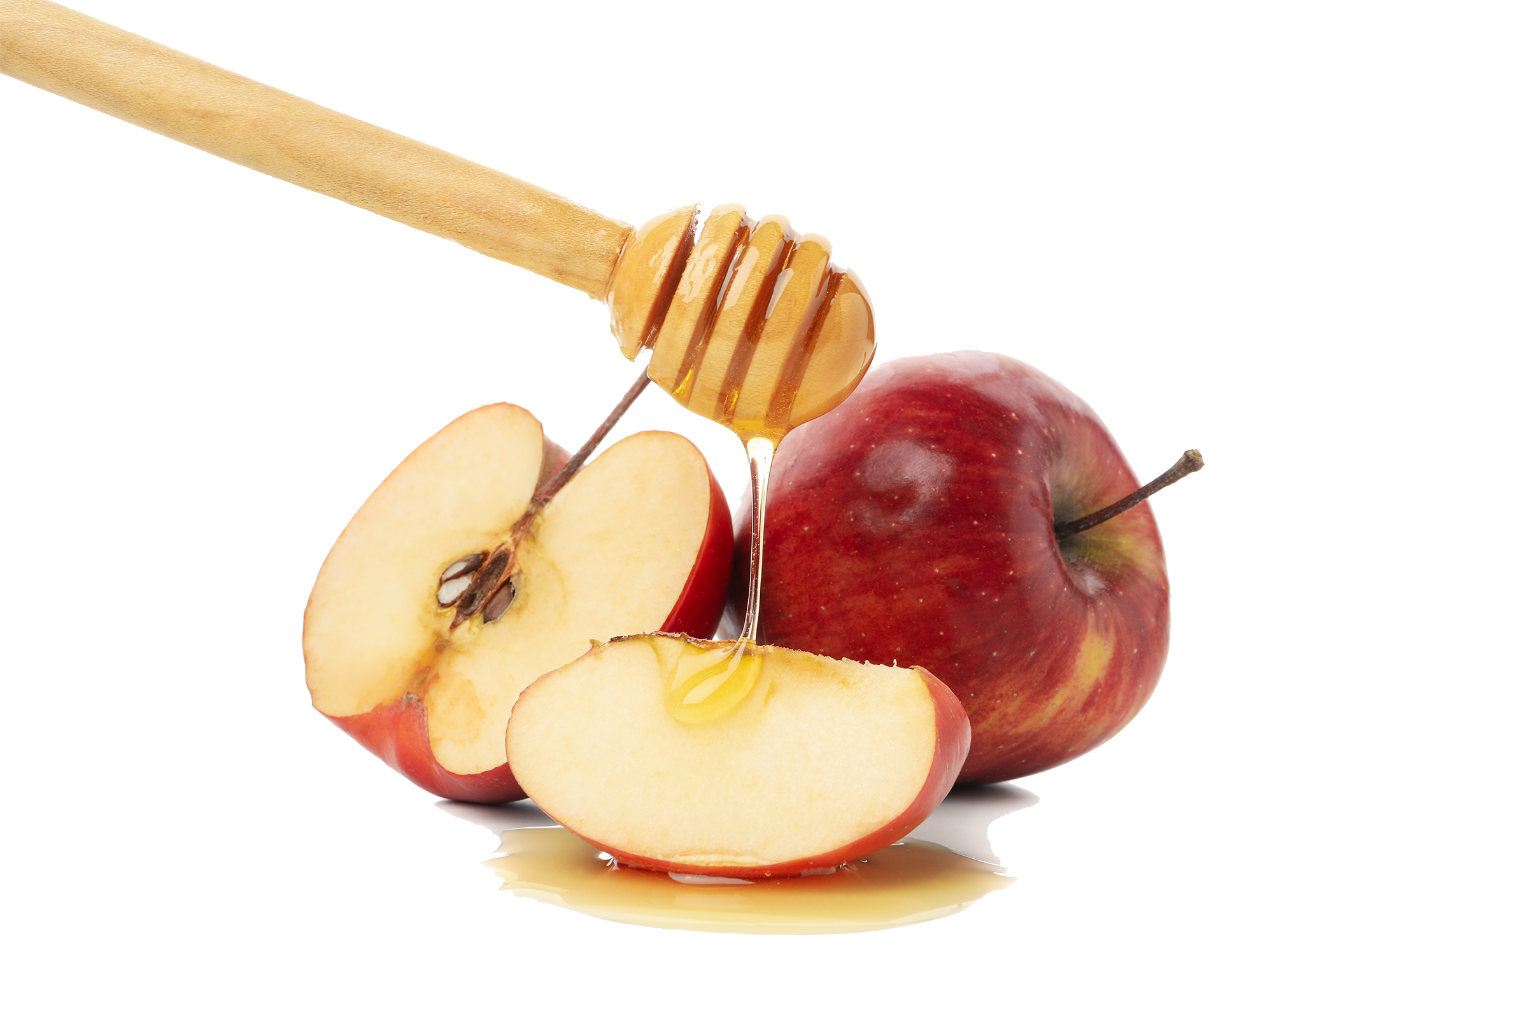
Apple in Honey

Slide 17
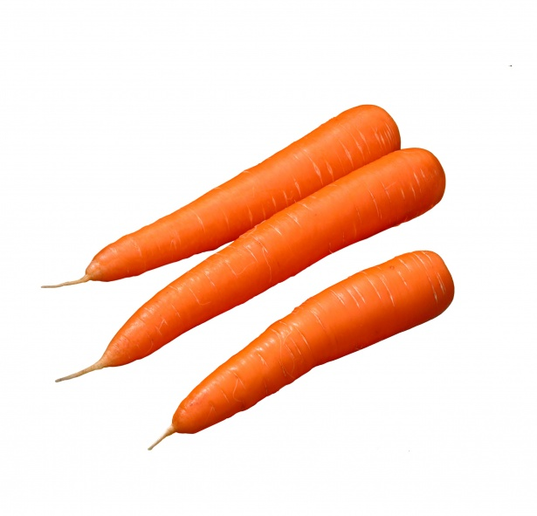
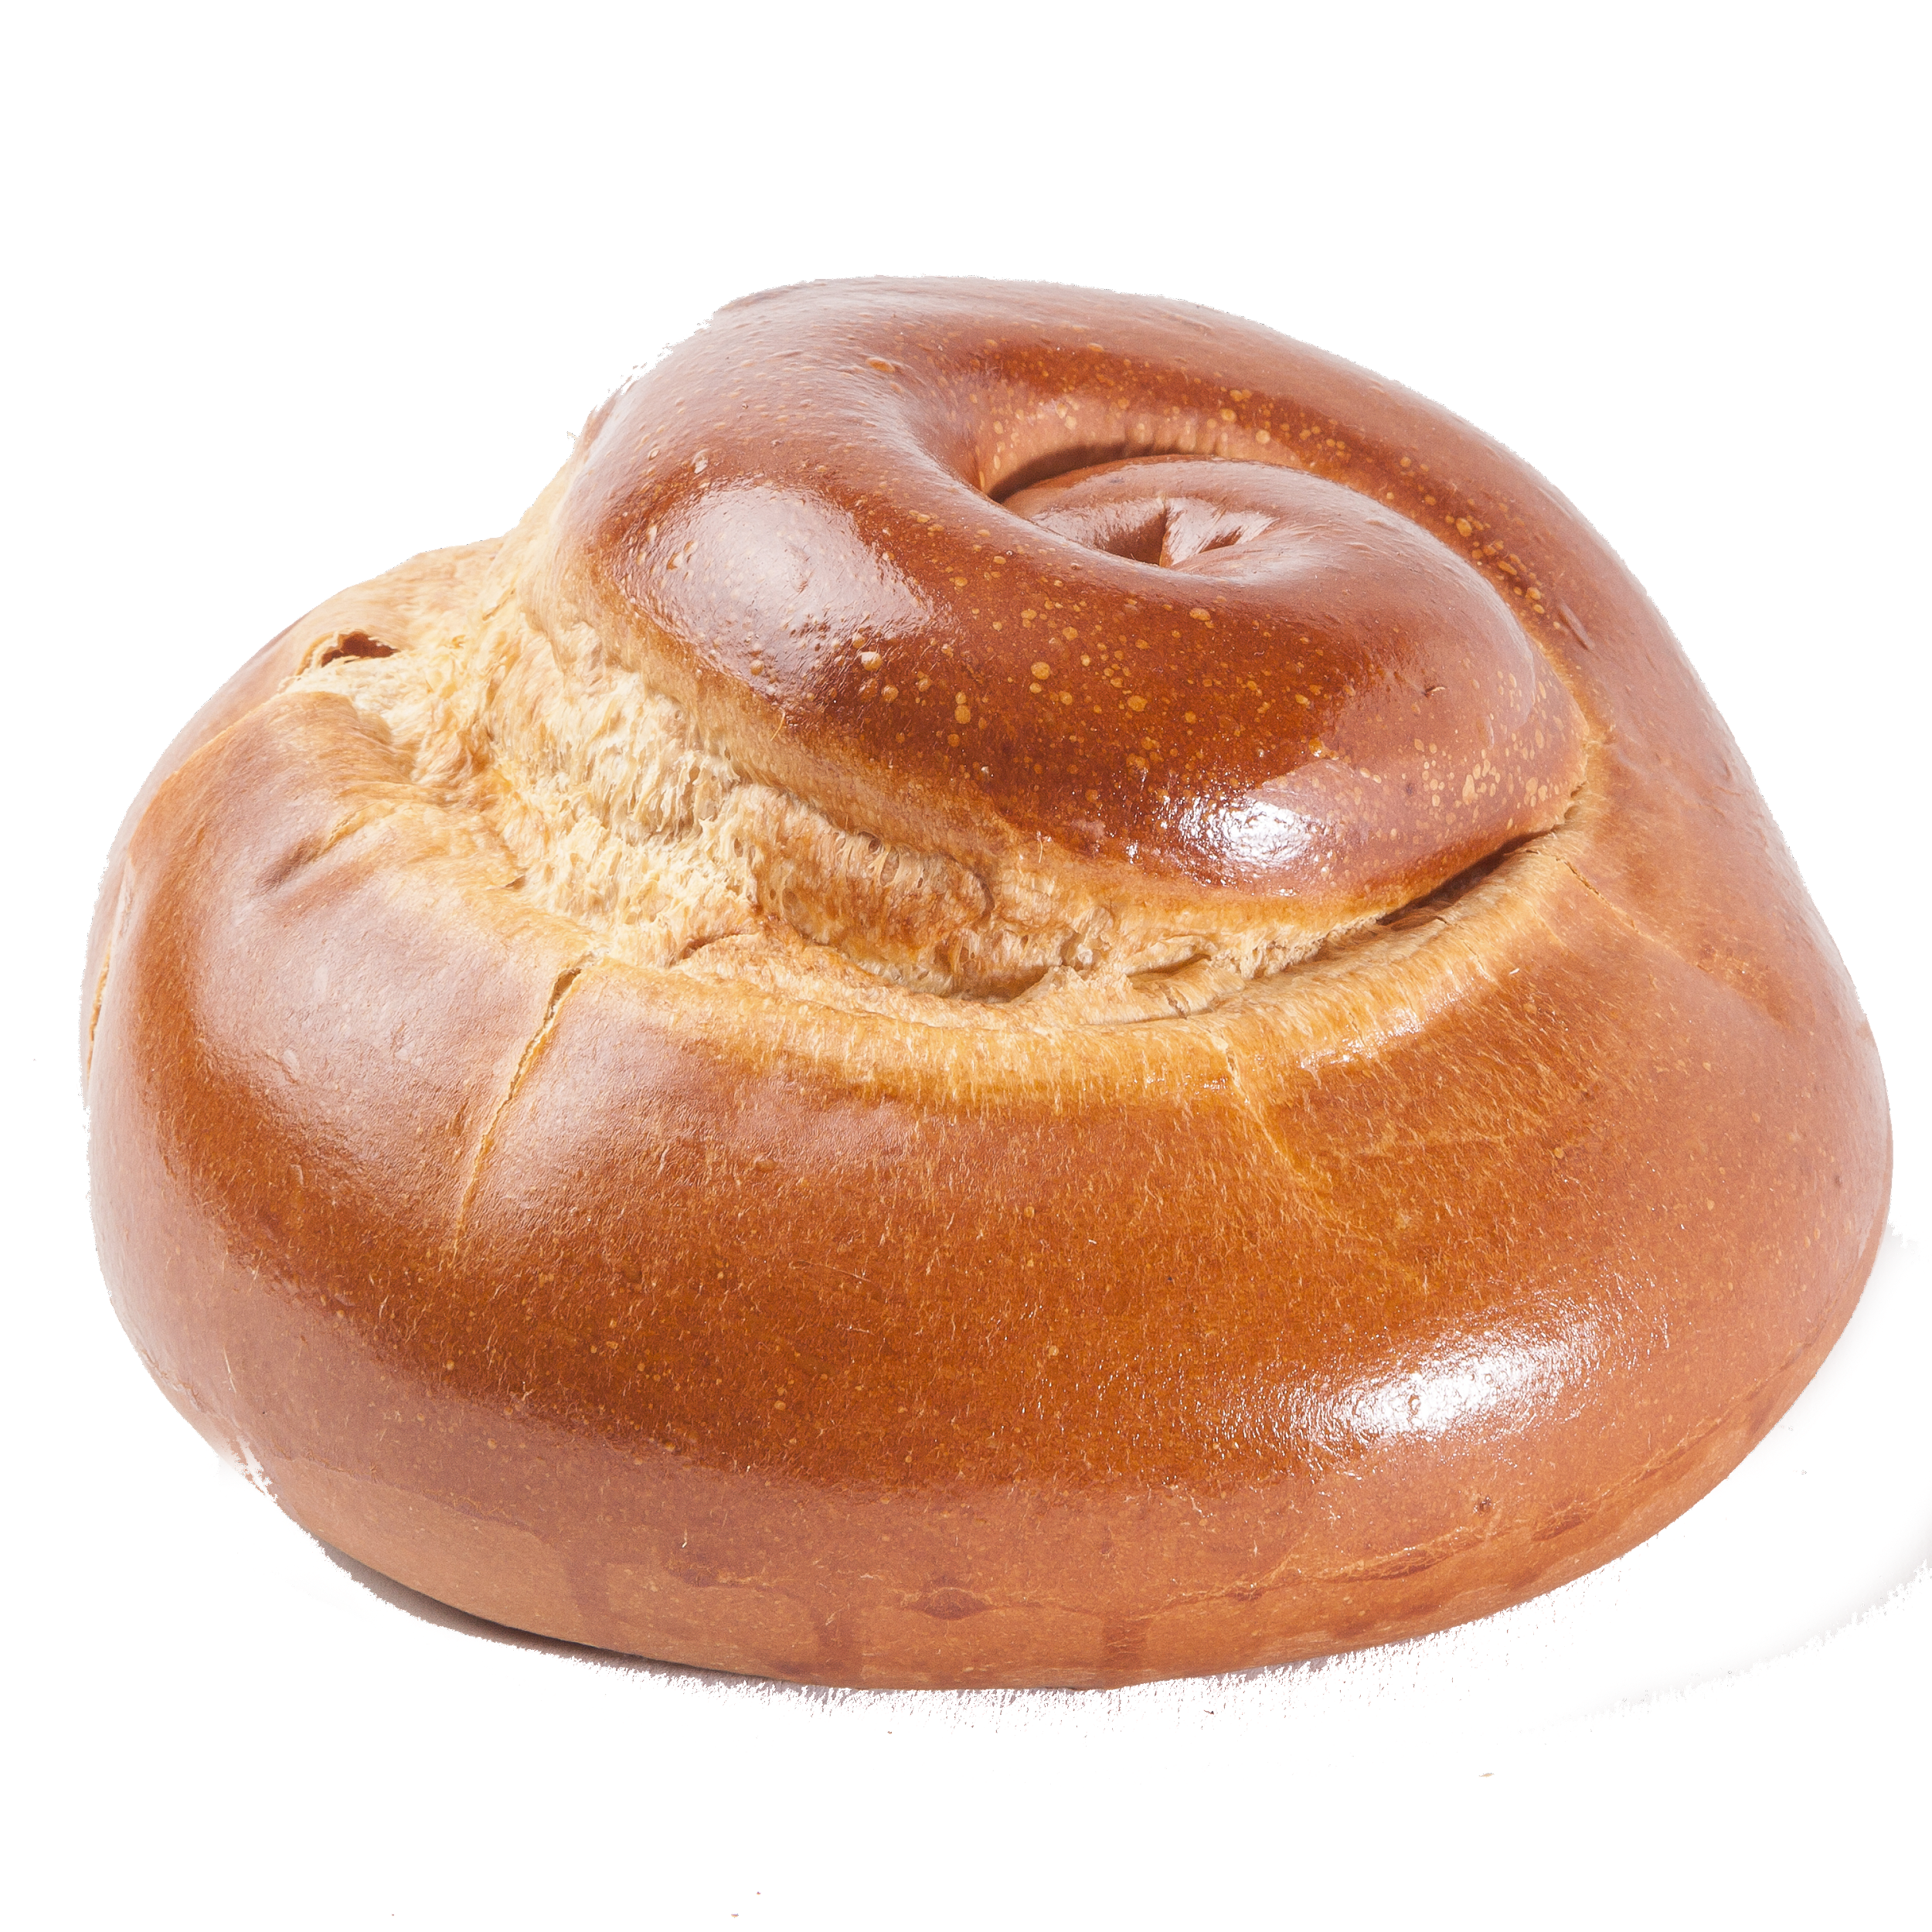
Carrots - Meren
Round Challah

Slide 18
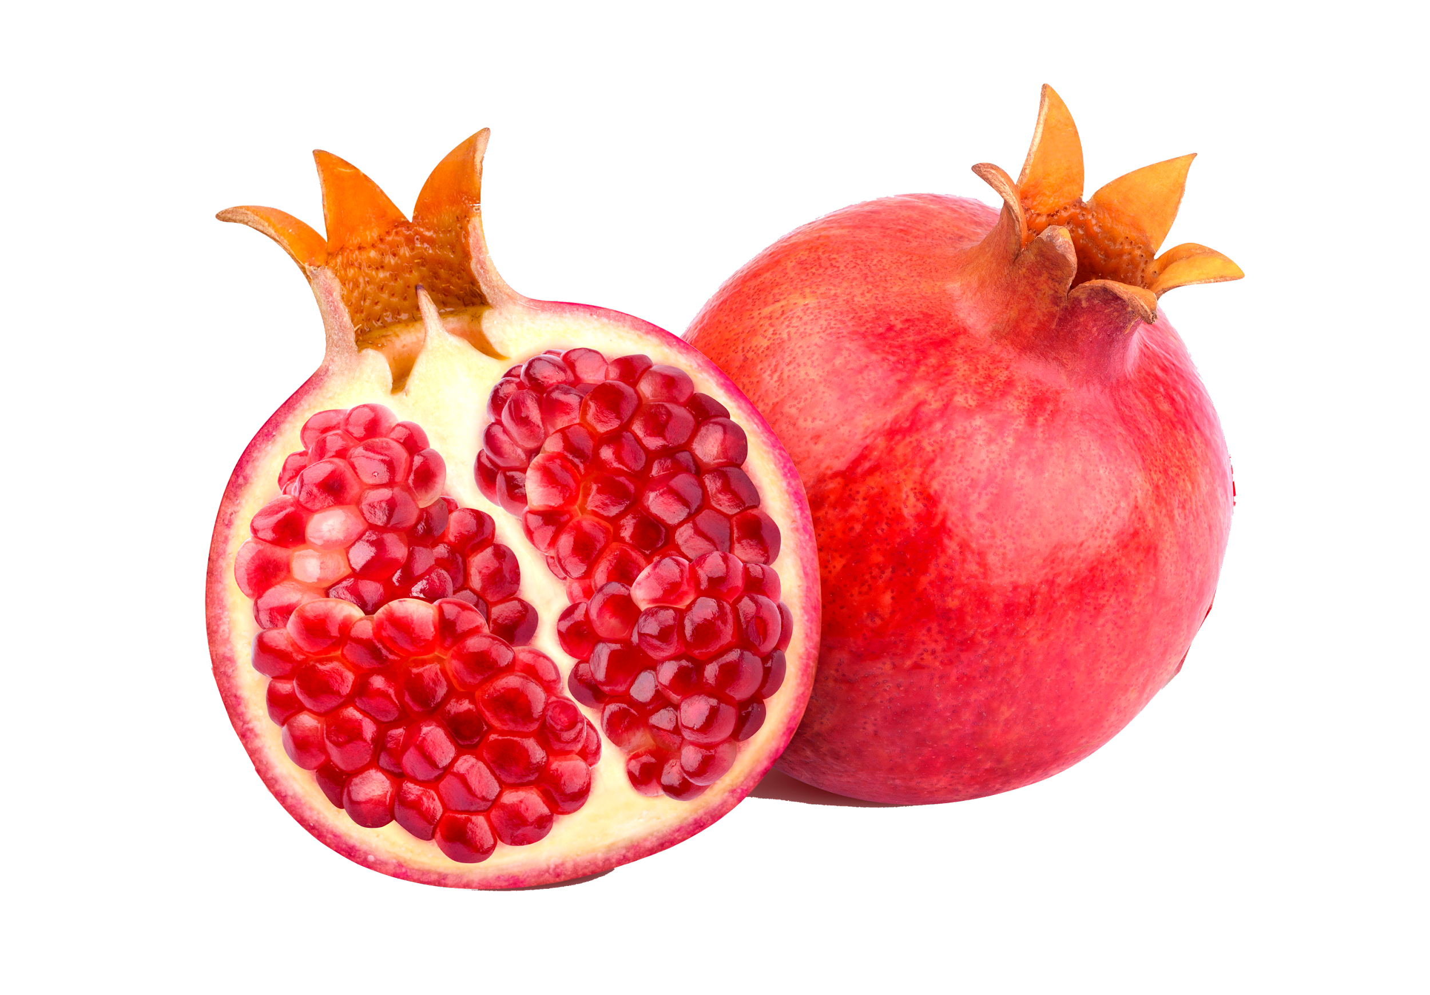
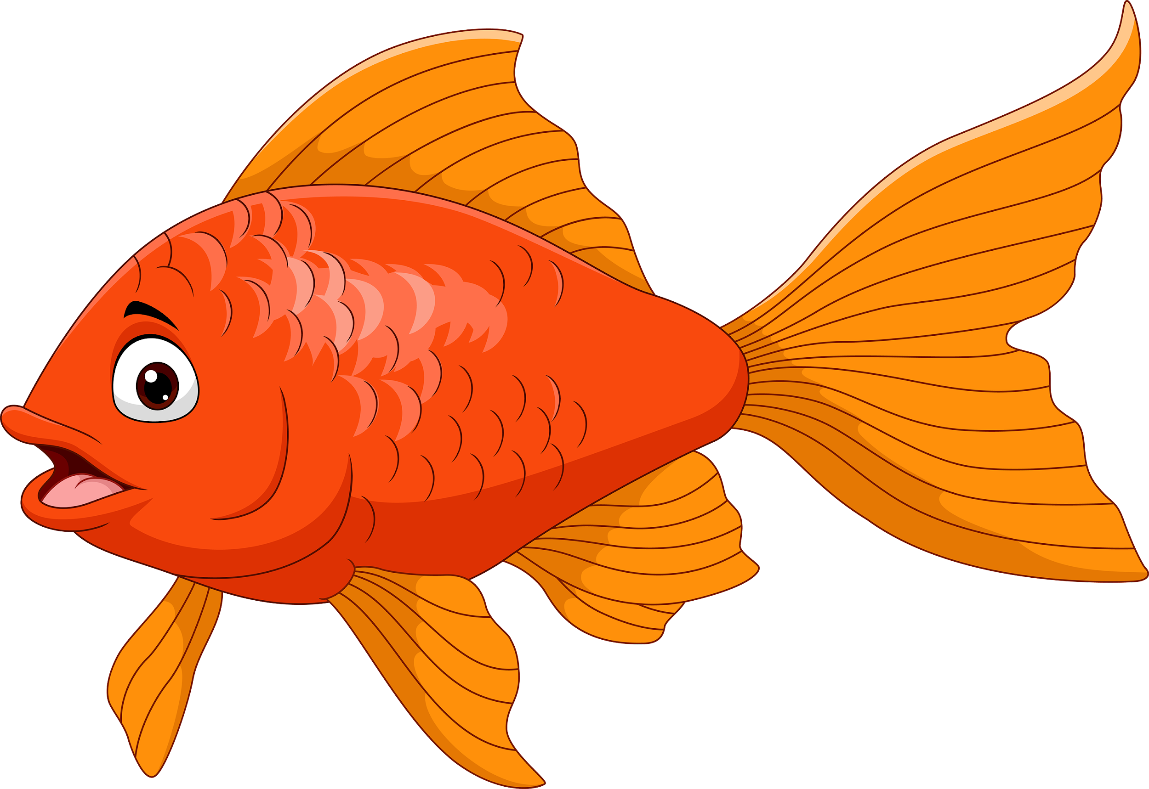
Head of a Fish
Pomegranate

Slide 19
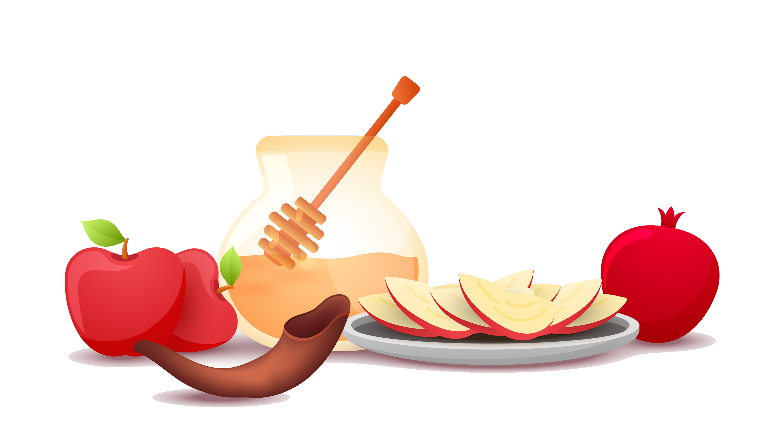
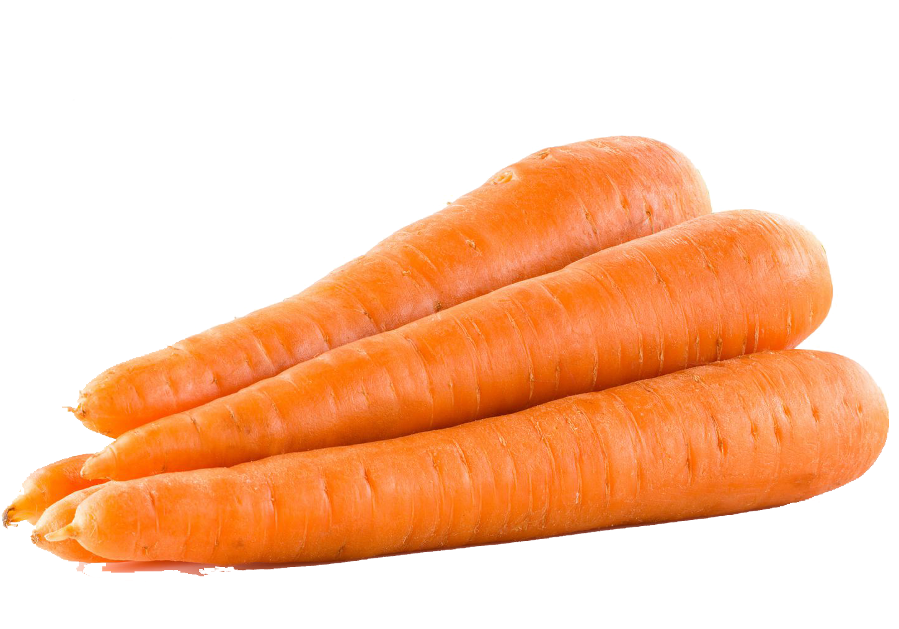
Our
Rosh Hashanah Menu
Carrots
Pomegranate
Apple in Honey
Round Challah
Head of fish

Slide 20
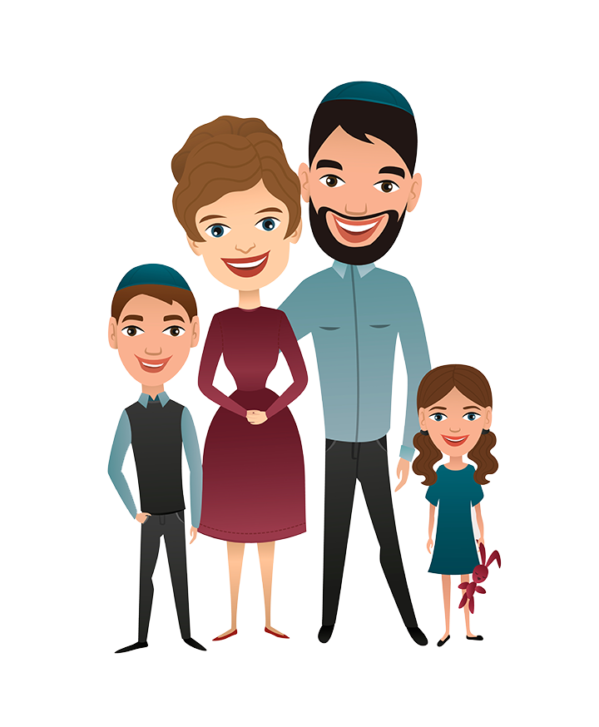
Tashlich - Throwing out all our Sins
Topic 2
Despite being red, Mars is actually a cold place full of iron oxide dust

Slide 21
שנה טובה
Wish someone else a sweet new year!
Dear Jack,
שנה טובה
Create your own Shana Tova Card

