Slide 1
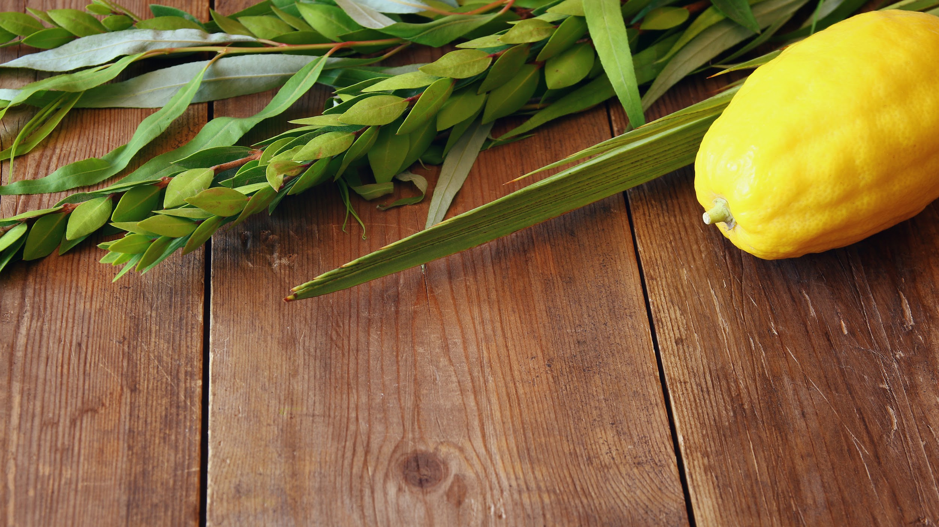
Festival of Sukkot
בס’’ד
K-2
Hashem’s Special Protection

Slide 2
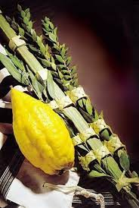
Our Sukkot Activities
Why do we celebrate Sukkos?
The special protection of Hashem.in the midbar after the Jewish people left mitzrayim.
How do we build a Sukkah?
Learn how a sukkah is made and all the important details
What do we say a bracha and shake on Sukkos?
The different parts of a lulav and esrog set.

Slide 3
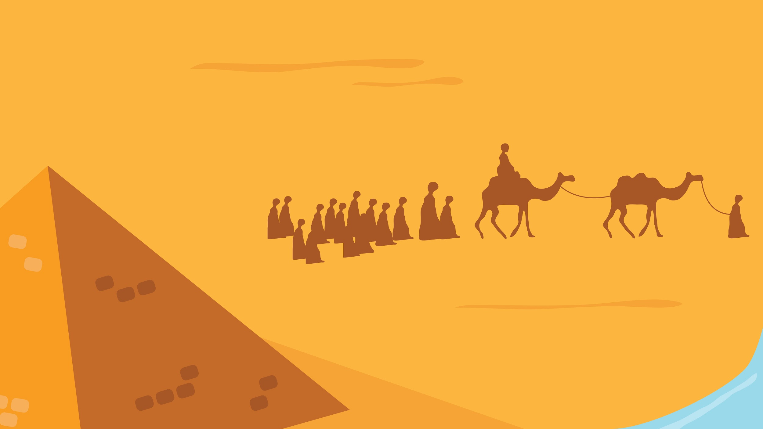
When the Jews left Egypt and were traveling in the desert, what protected them?

Slide 4
Hashem’s Clouds
TTTO: Hokey Pokey
There were clouds on top (wave arms above head)
There were clouds below
(wave arms downward)
There were clouds behind the Jews (jump around to face the back)
And in front of them, too (jump back to face forward)
Clouds were on the right (reach to the right)
Clouds were on the left (reach to the left)
That’s how Hashem protected the Jews (clap twice)

Slide 5
How did the clouds protect the Jews travelling in the desert?

Slide 6
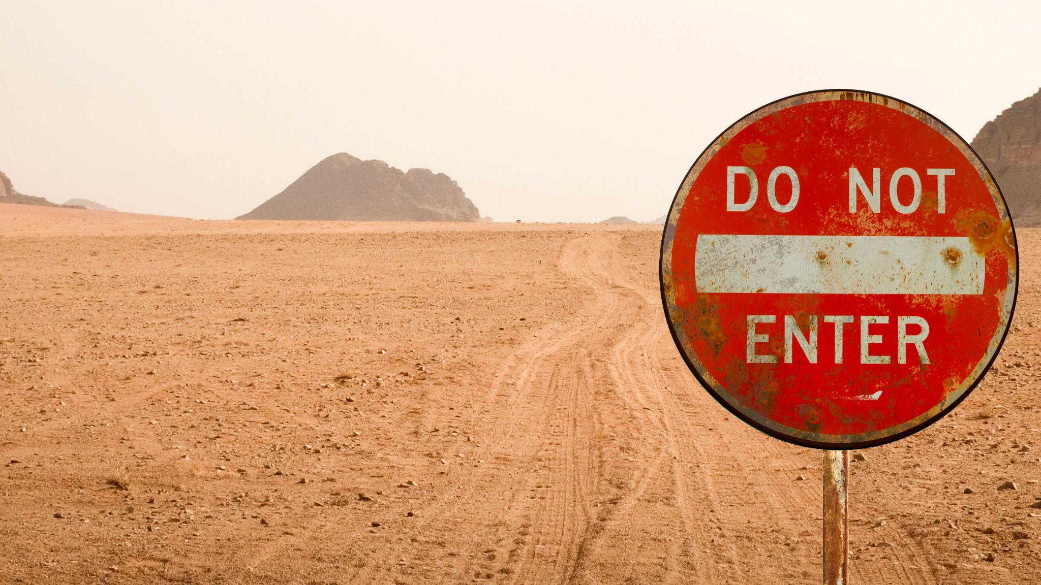
Dangers of the Desert

Slide 7
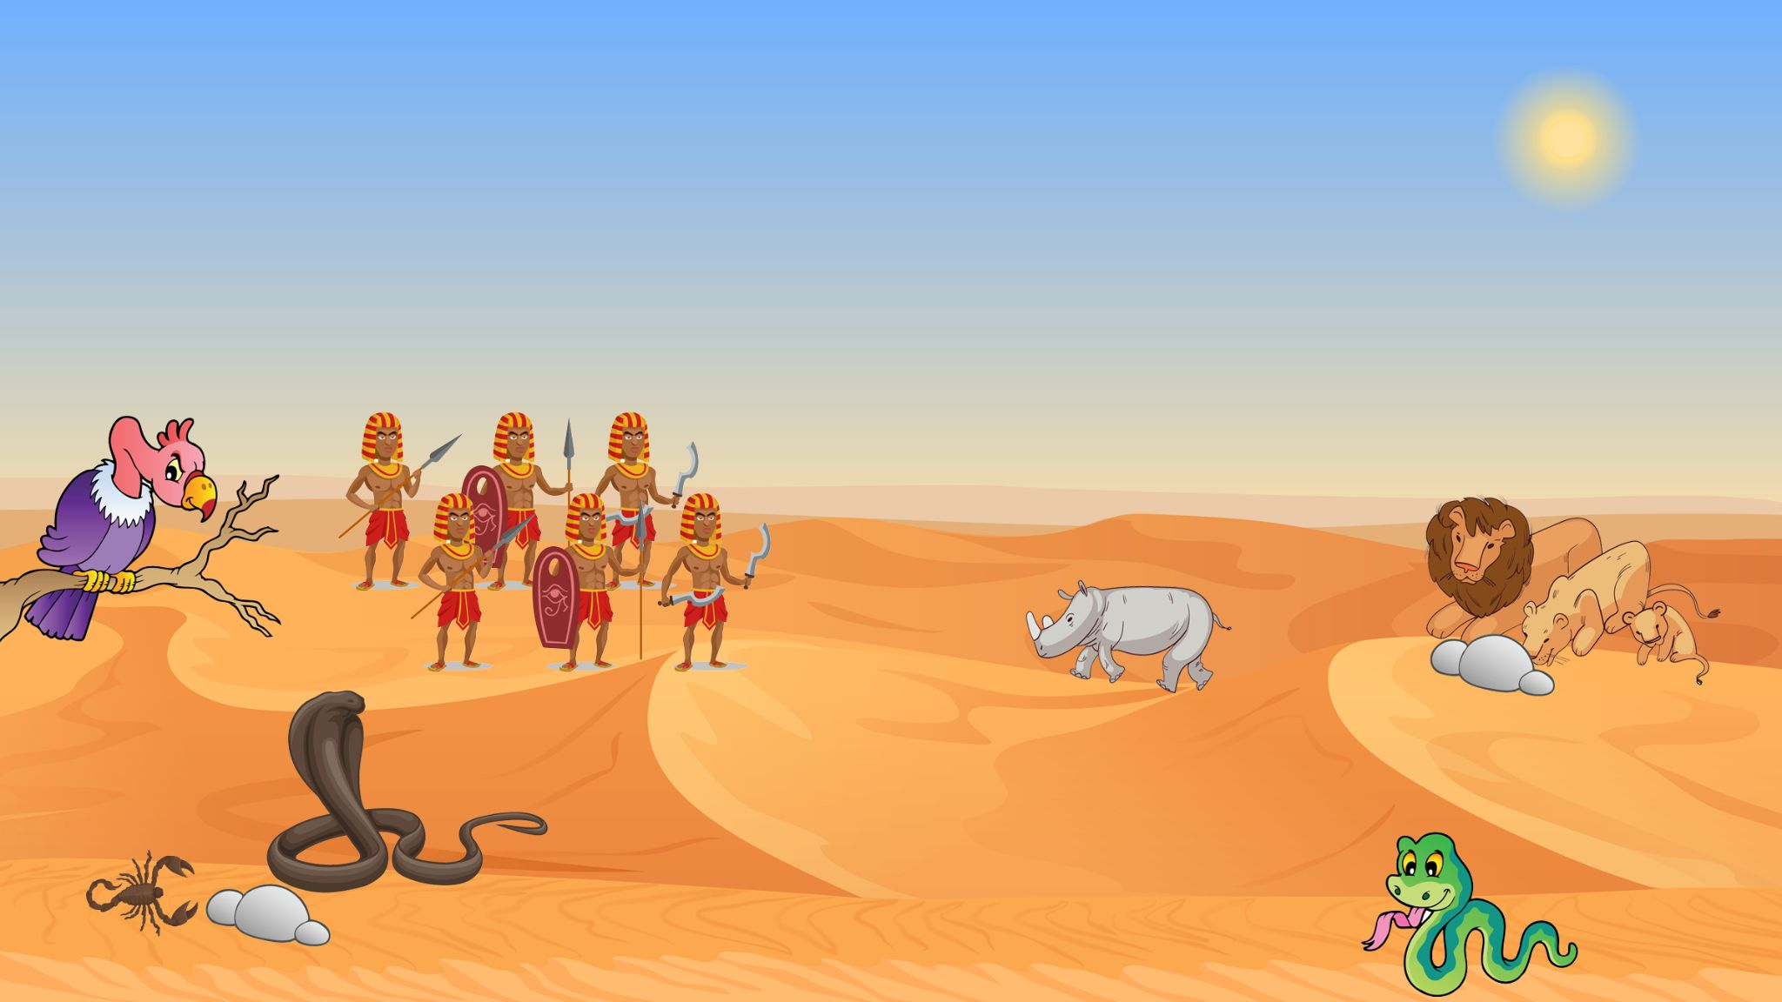
Sun
Dangers of the Desert
Rocks
Vultures
Enemy Soldiers
Wild Animals
Snakes
Scorpions

Slide 8
The Blessing of the clouds

Slide 9
The Sukkah
What is a Sukkah?
What does a Sukkah have for a roof?
What will happen if it rains while you are in your sukkah?
What do you think sitting in a Sukkah teaches us?

Slide 10
The Sukkah Song
TTTO: I have a little Dreidel
I have a little Sukkah with four walls and a door.
It doesn’t have a ceiling, it doesn't have a floor.
The S'chach will be the ceiling, the ground will be the floor.
We will say a special blessing,
We’re ready now for sure.

Slide 11
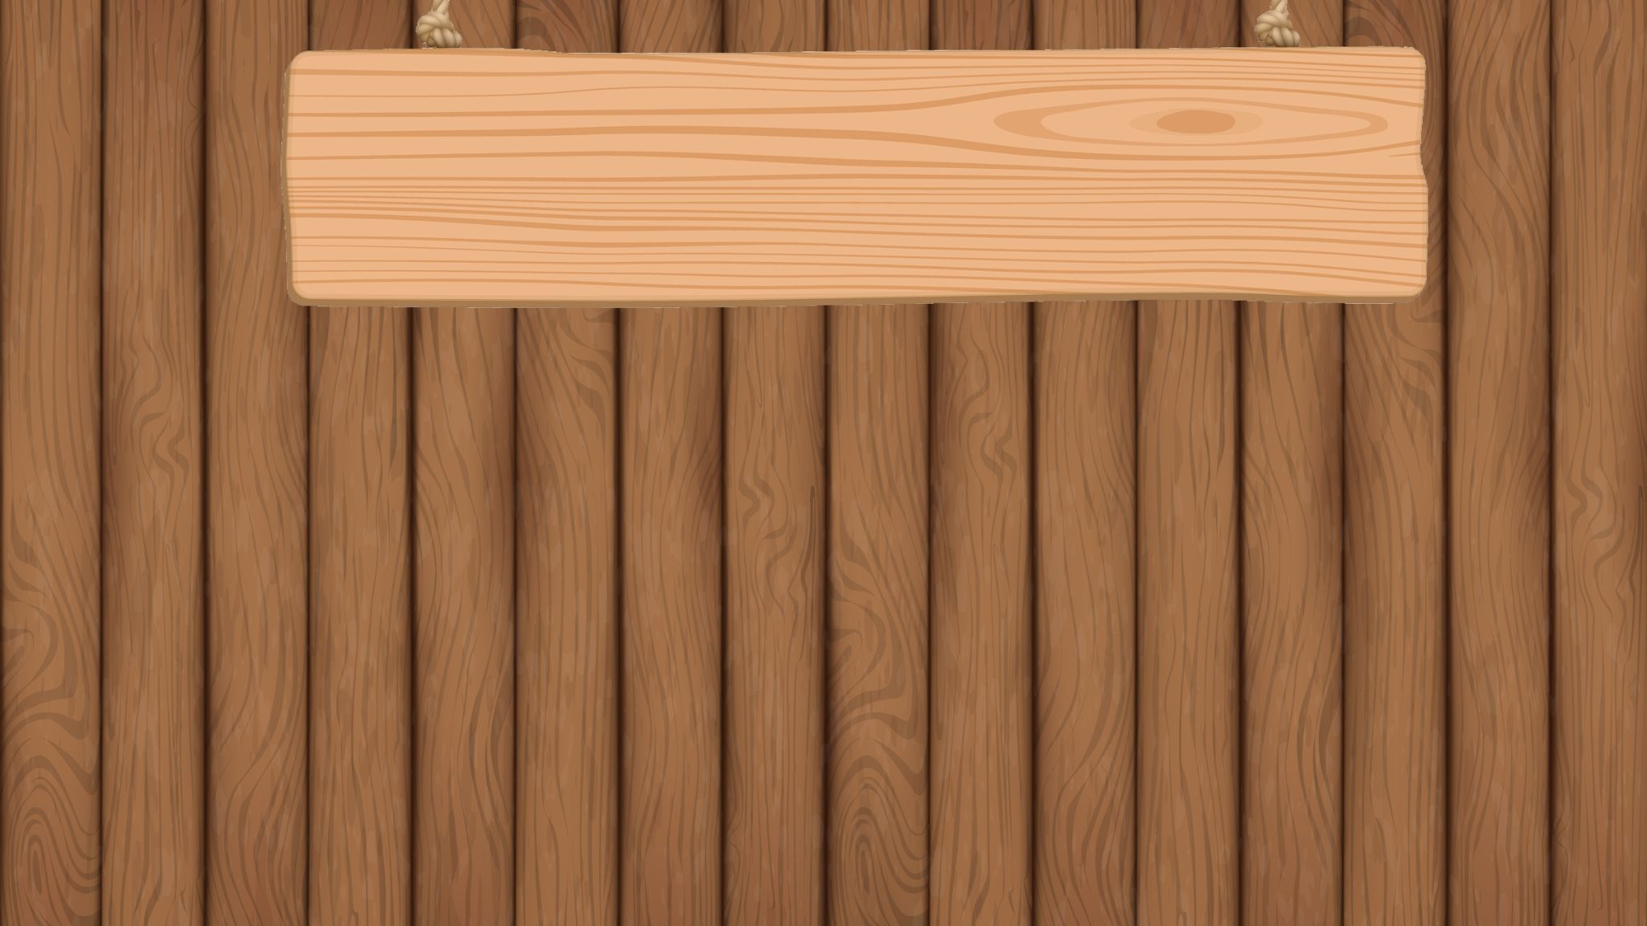
How do we build the Sukkah?
Branches
Hammer
Wood
Saw
Drill
Nails

Slide 12
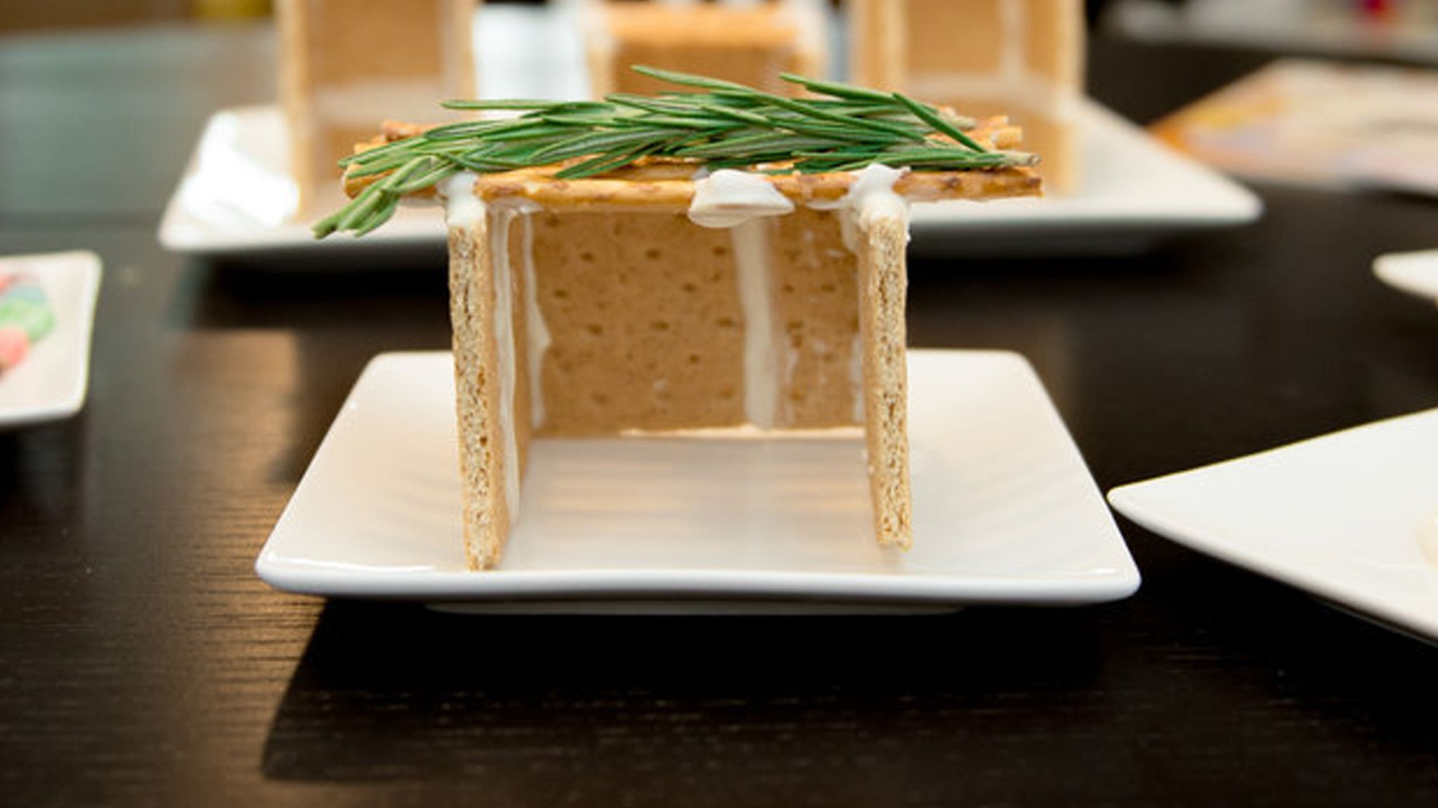
Edible Sukkah

Slide 13
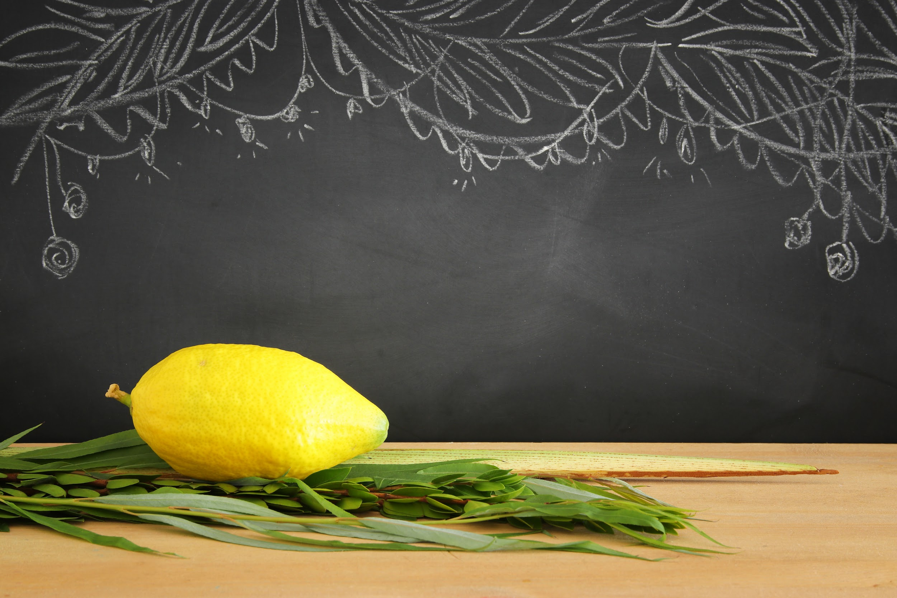
The Lulav & Etrog
The second Mitzvah that we do on Sukkot is to shake the Lulav and Etrog.
We take four kinds of plants, bring them together, say a blessing, and shake them.

Slide 14
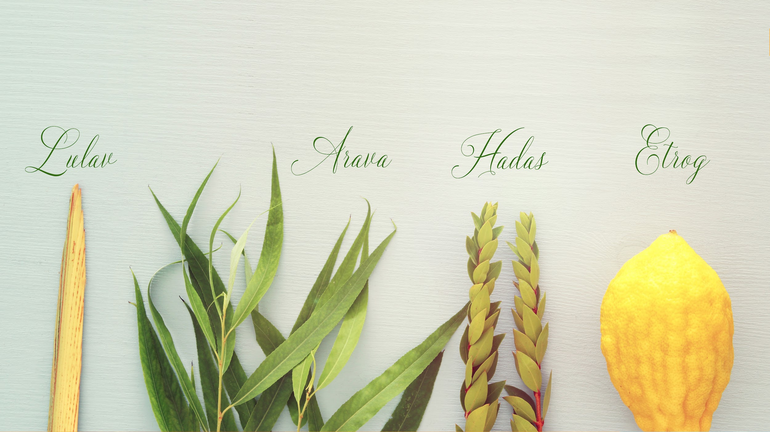
The 4 Kinds

Slide 15
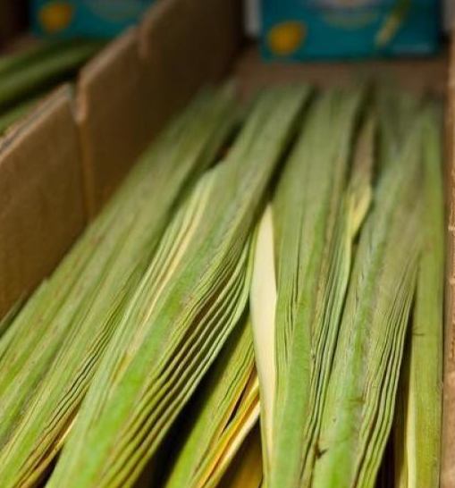
The Lulav
A branch from a palm tree

Slide 16
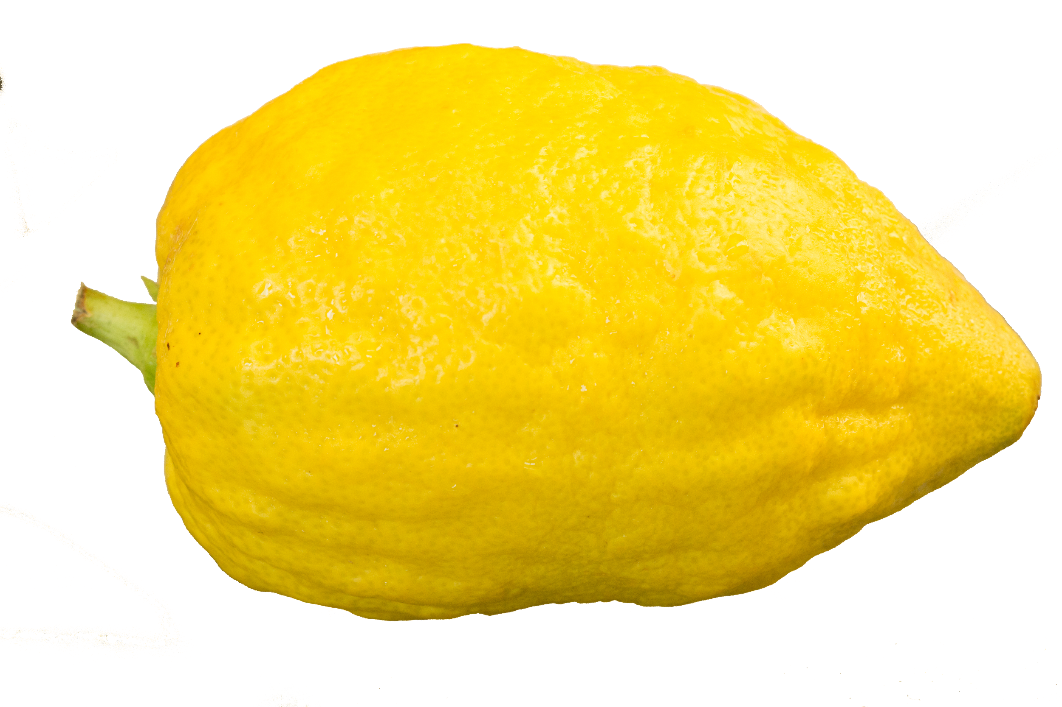
The Esrog
A fruit that sort of looks like a lemon.

Slide 17
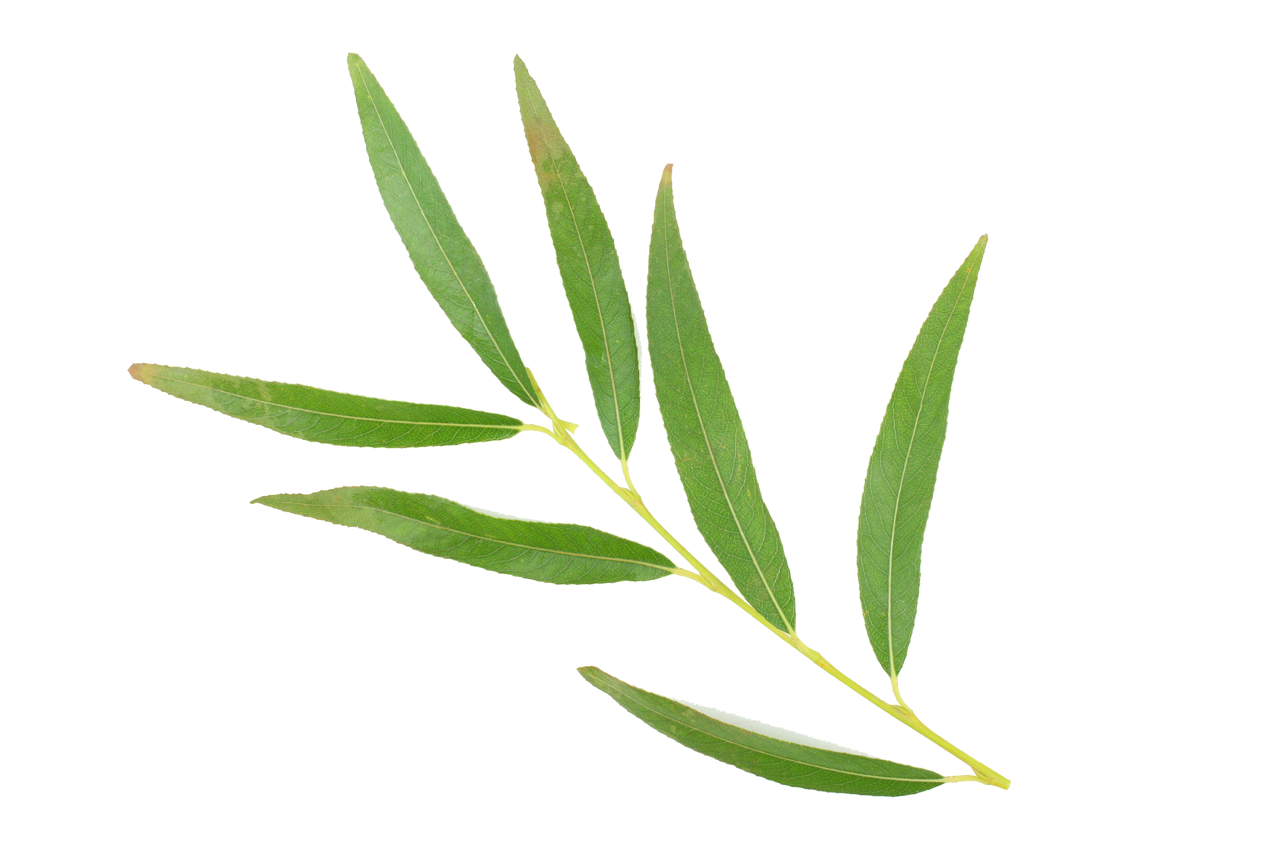
The Aravos
Willow Branch

Slide 18
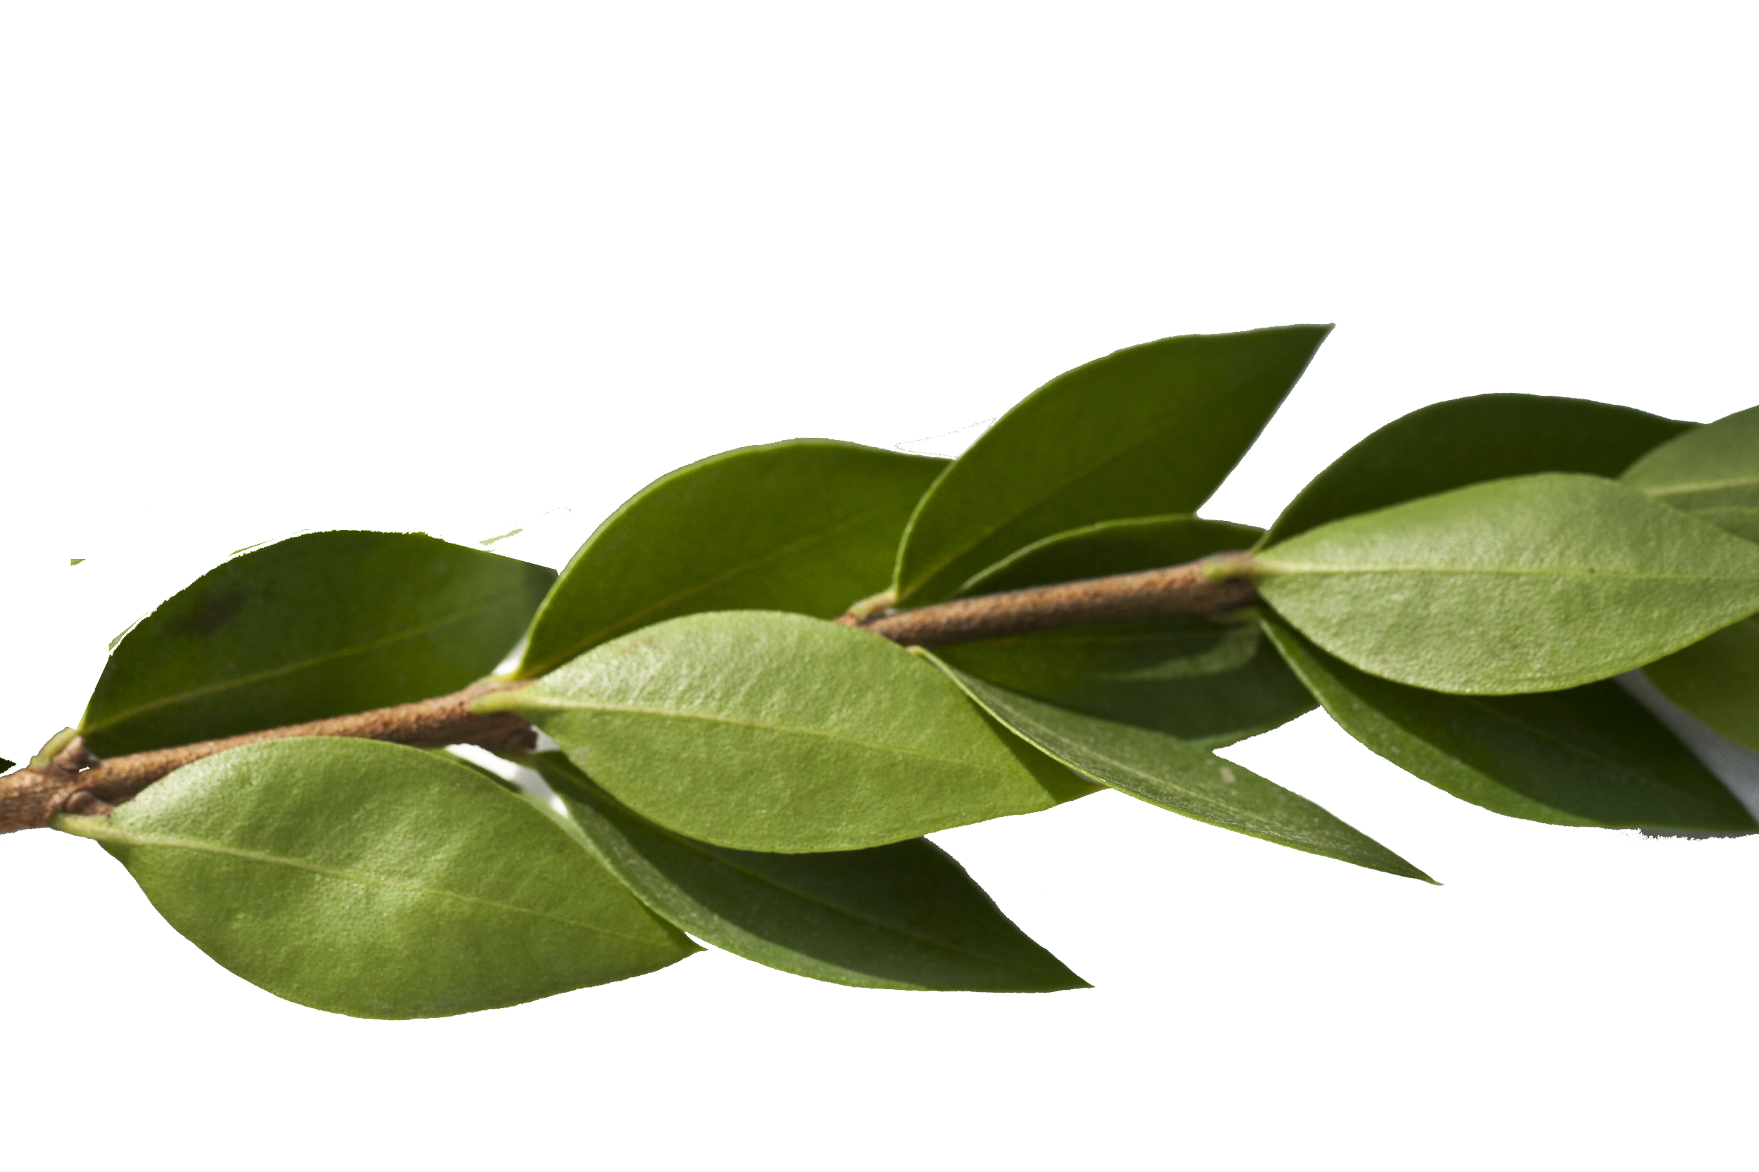
The Hadasim
Myrtle
(a type of branch with small leaves)

Slide 19
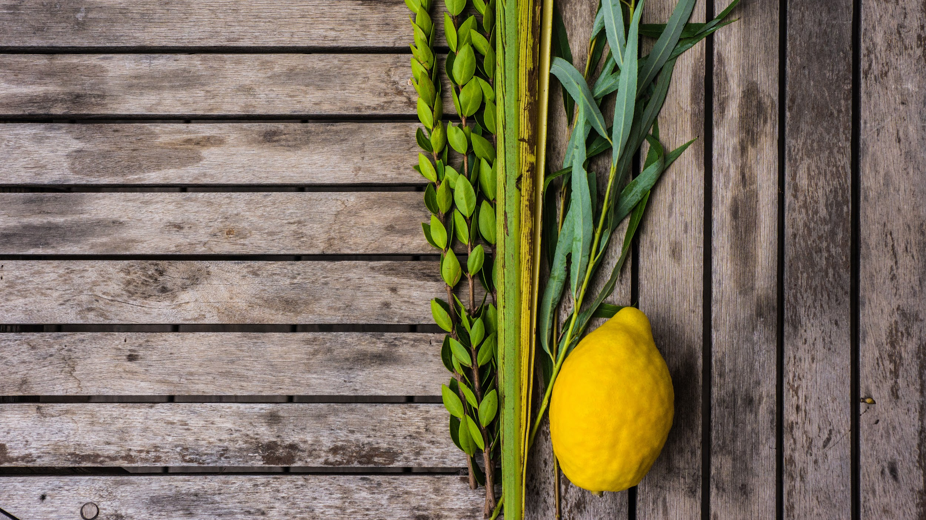
On Sukkos, we take all four kinds and hold them together, say a brcha and shake them in all six directions.

Slide 20
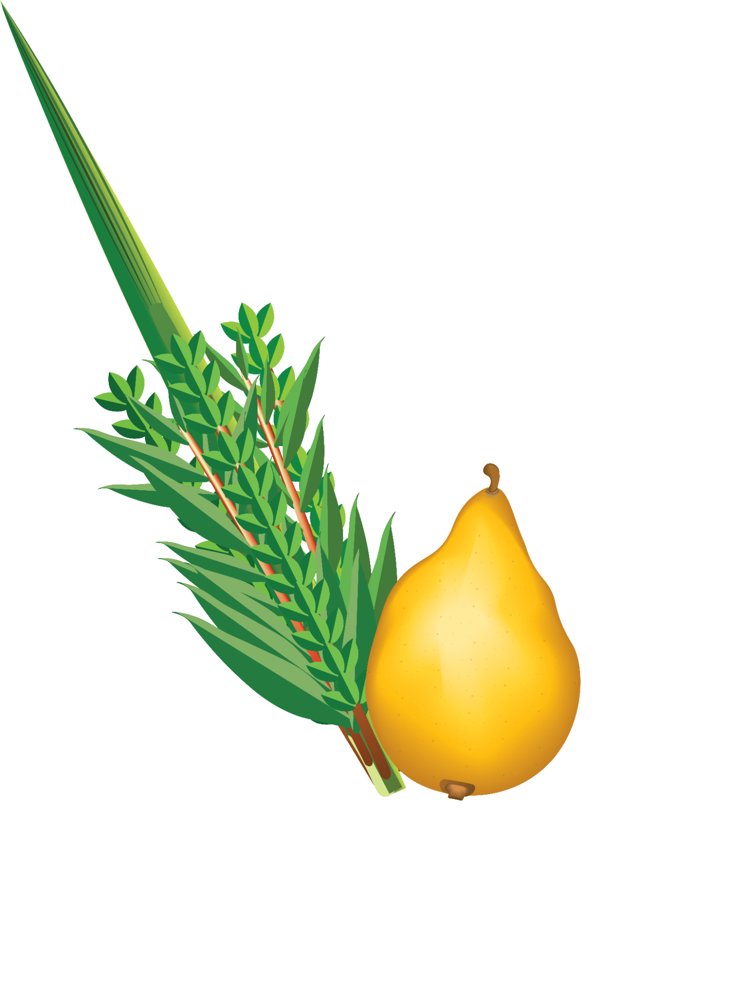
Hashem is here, Hashem is there, Hashem is truly everywhere x2
Up, Up
Down, Down,
Right, Left, All around,
Here, There, and Everywhere,
That’s where he can be found

