Slide 1
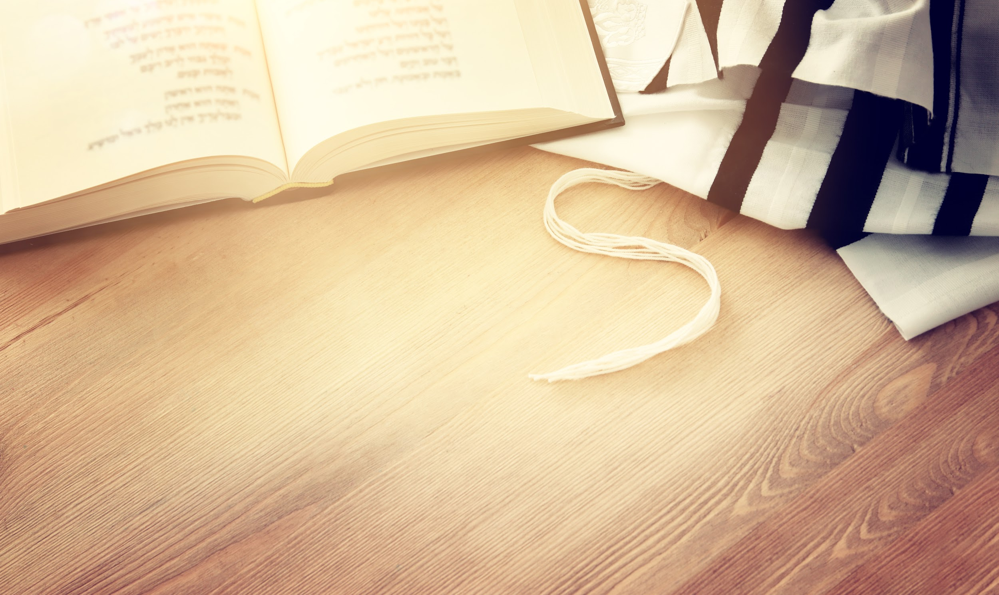
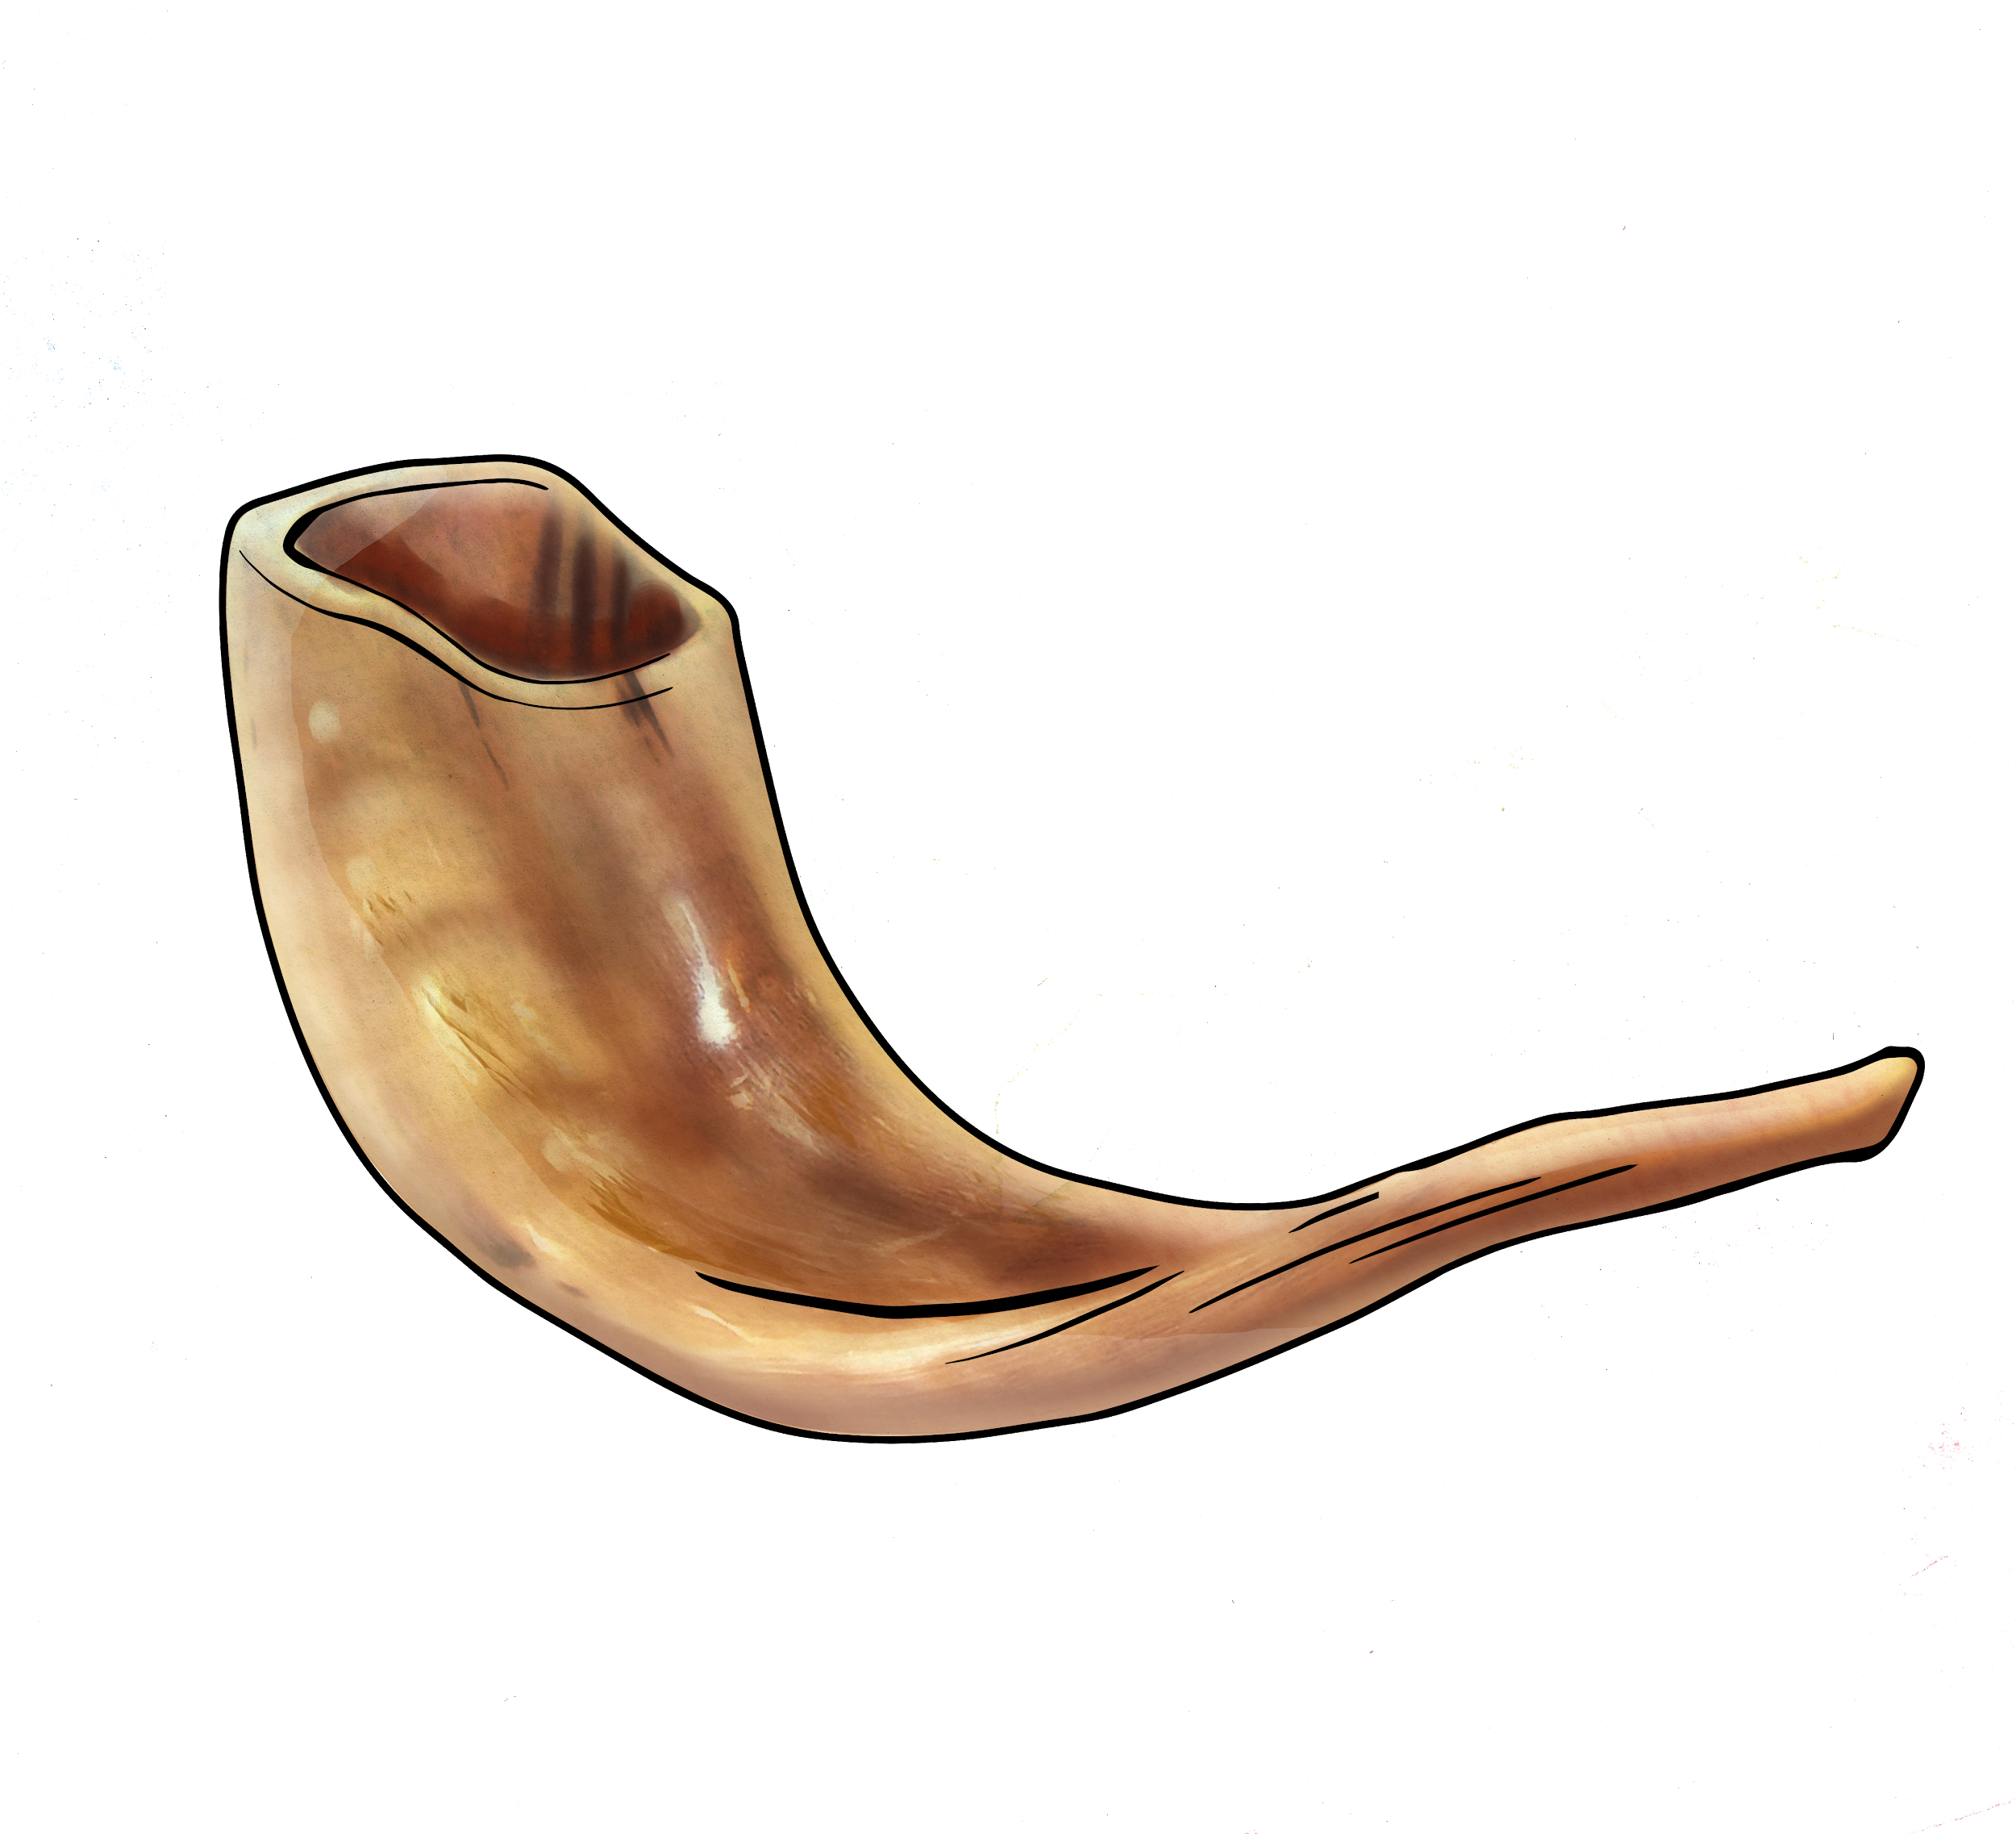
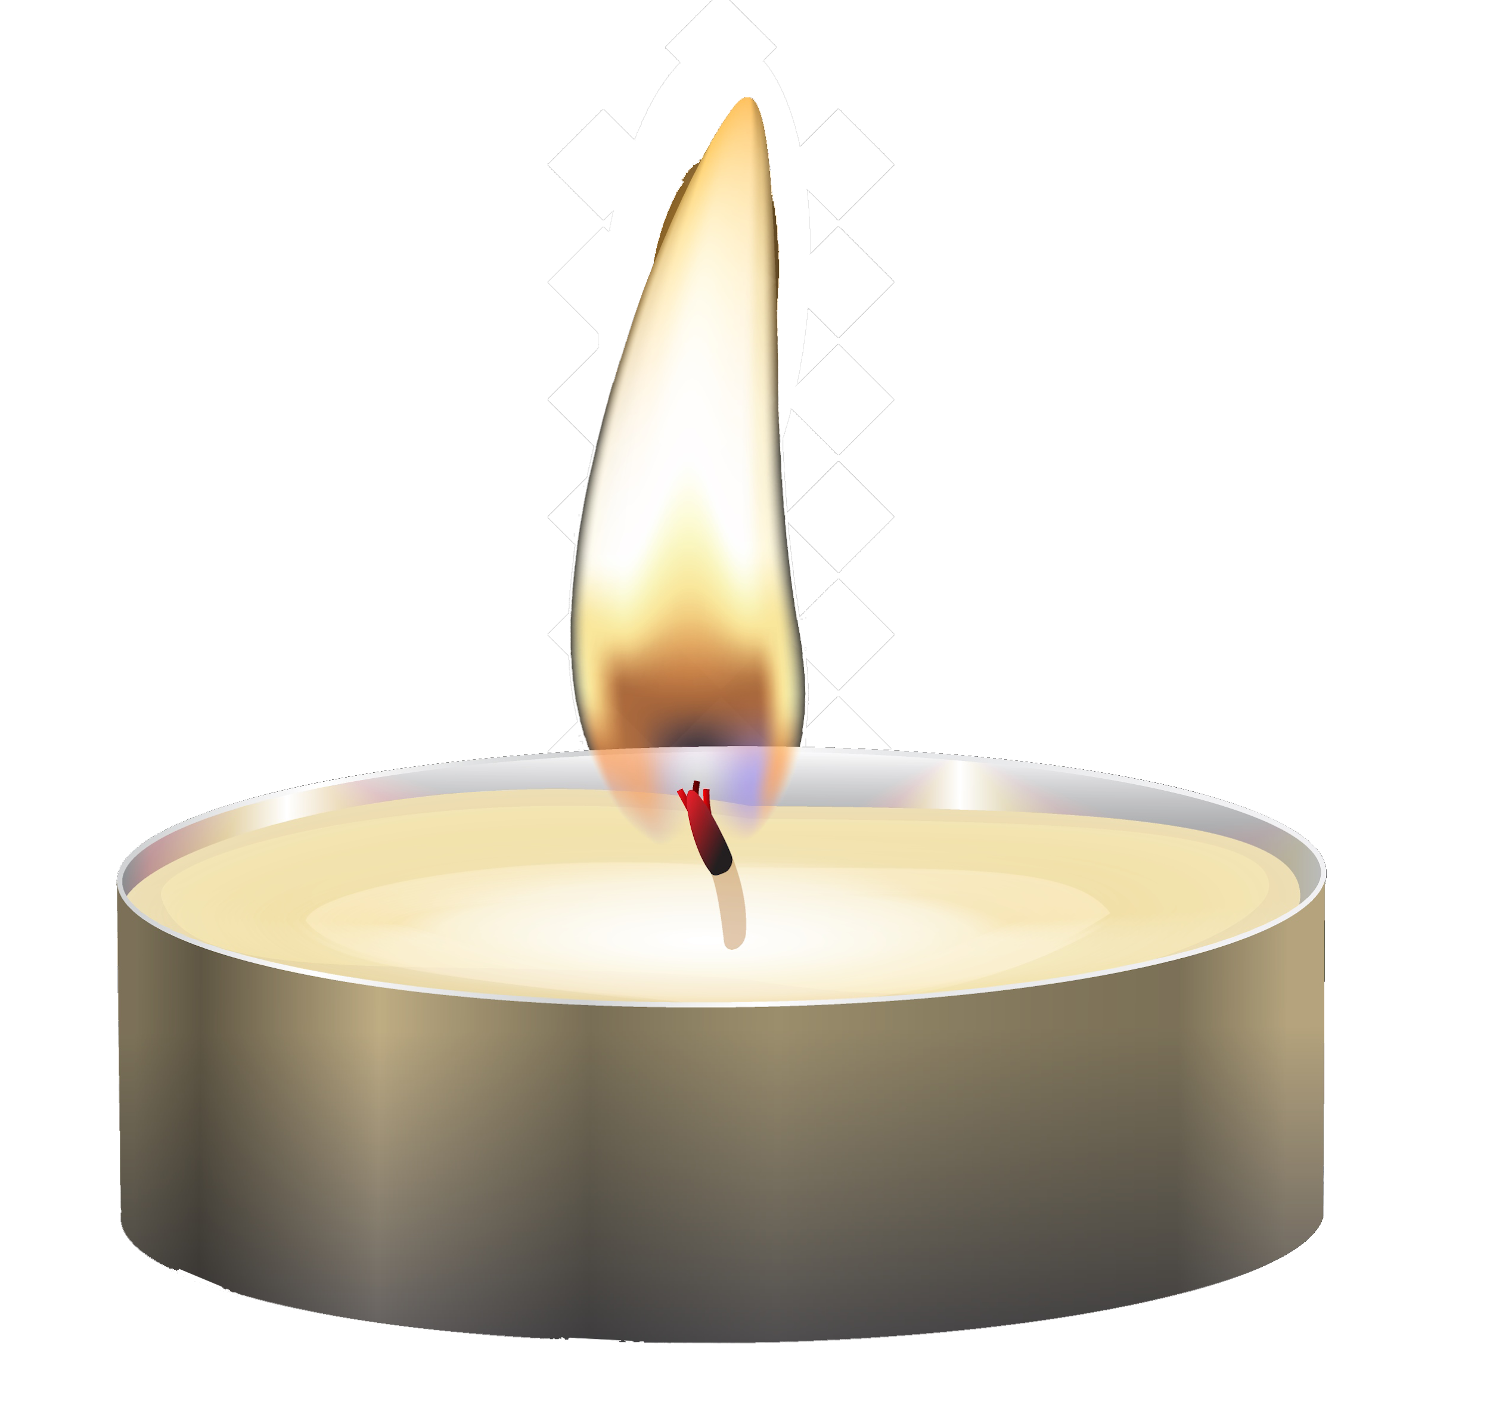
Yom Kippur
The Holiest Day of the Year
בס’’ד
Yaldei
What is Yom Kippur? How do we do Teshuva?
How do we observe Yom Kippur?

Slide 2
Can You Fix It?

Slide 3
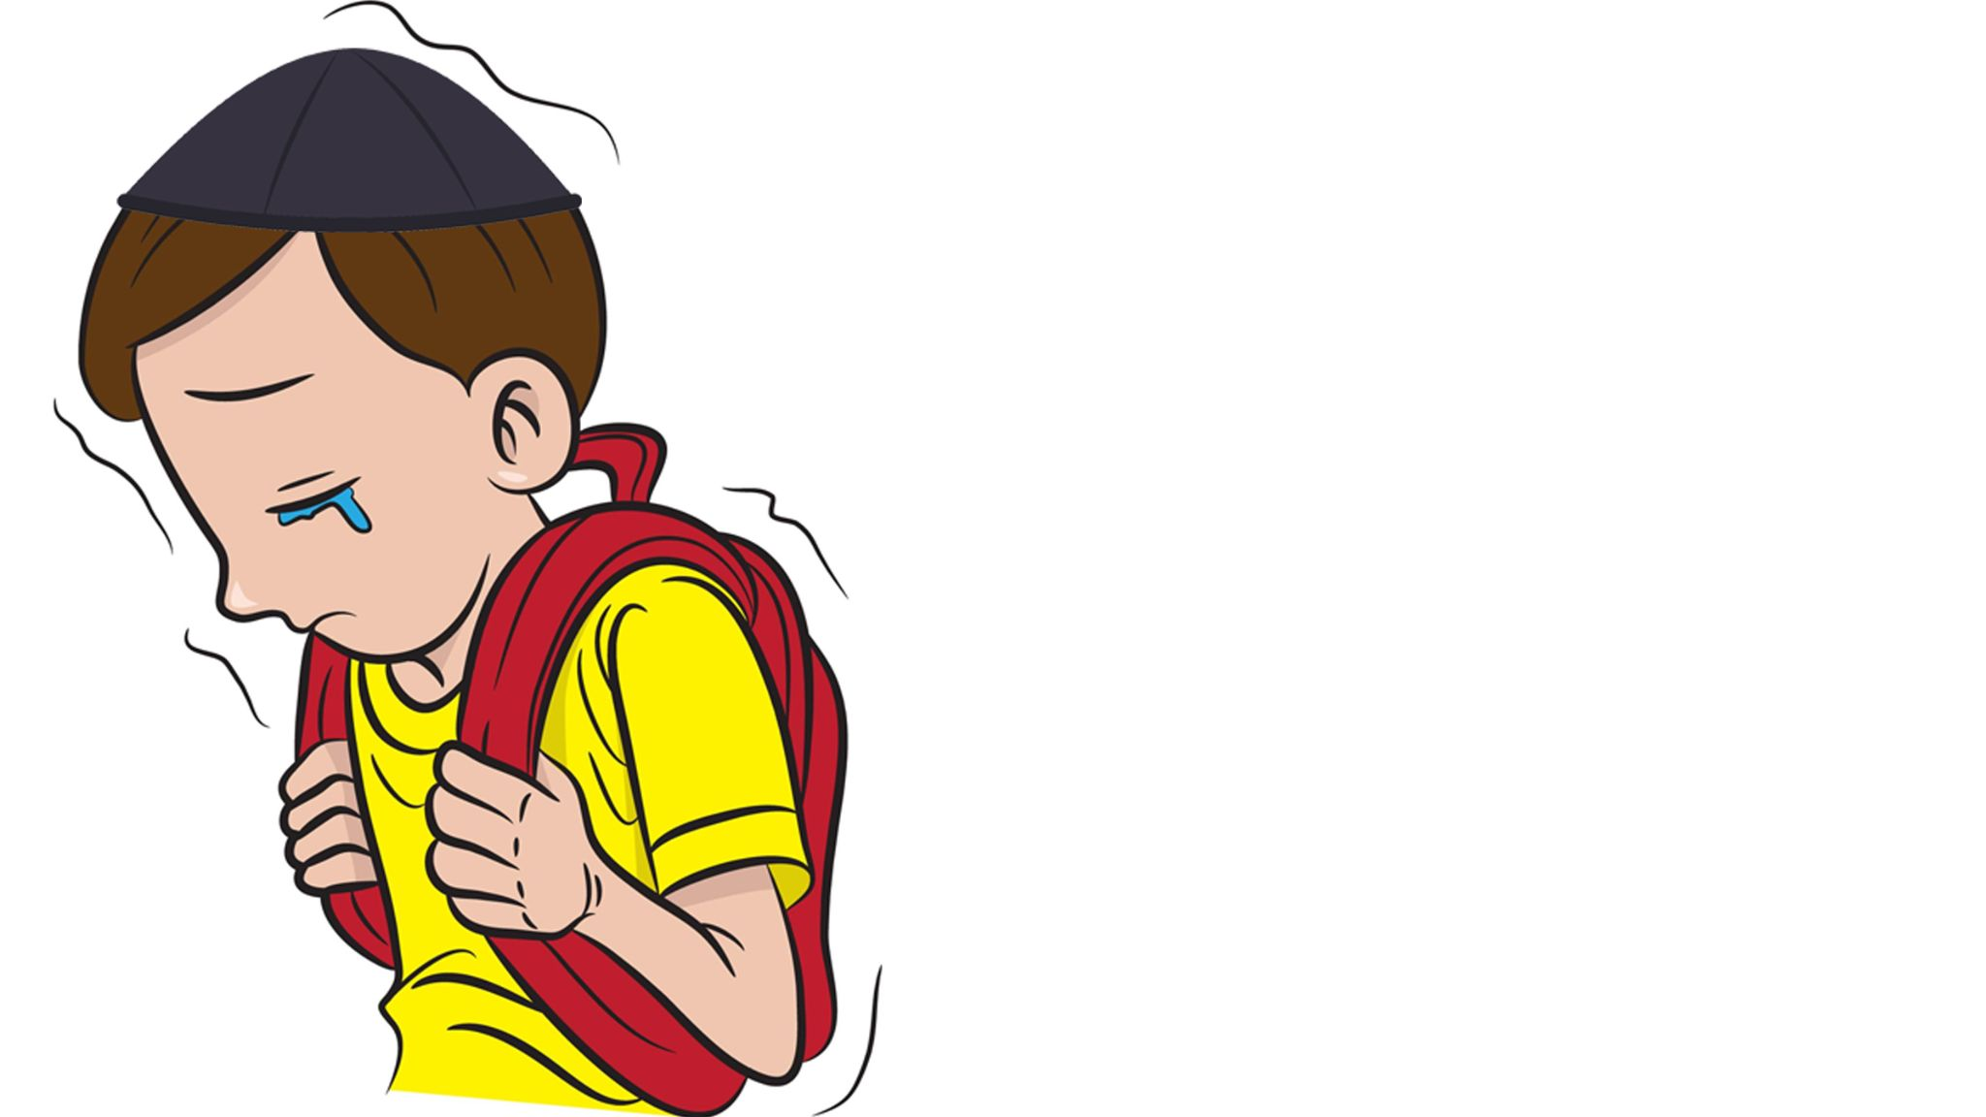
We all make mistakes but Hashem teaches us we can all do Teshuvah

Slide 4
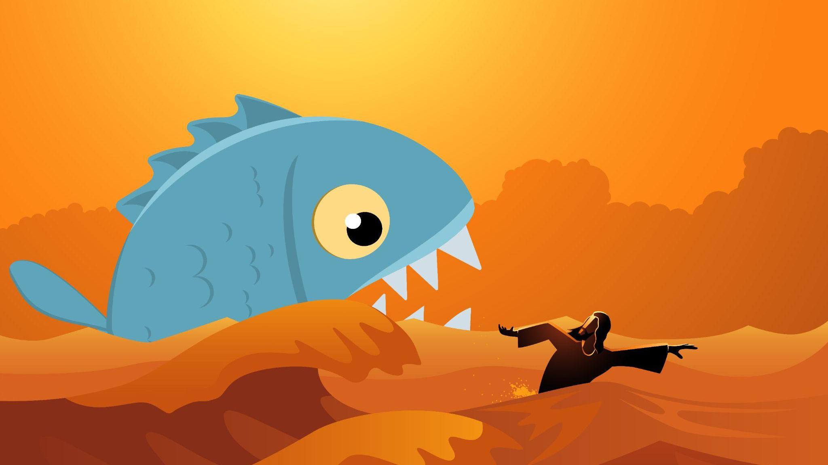
Yonah & the Whale

Slide 5
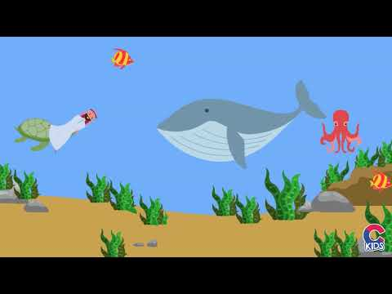
Story of Yonah

Slide 6
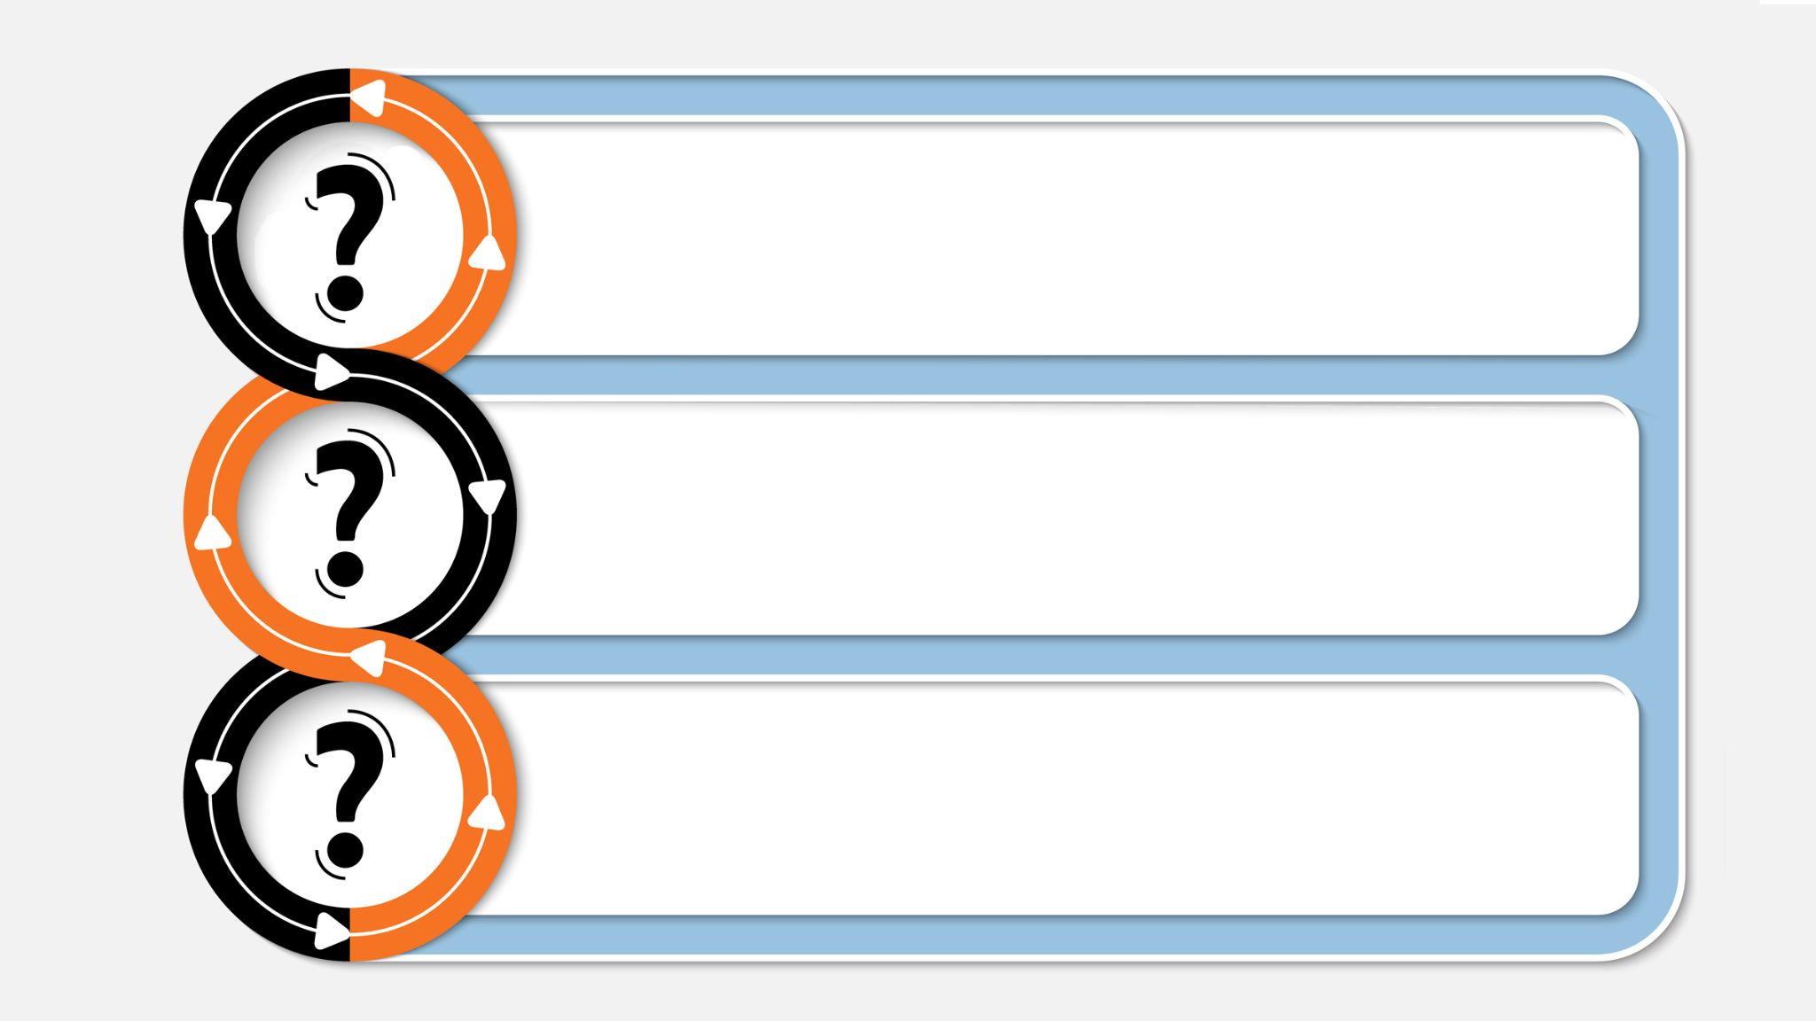
What did Yona do when he realized he made a mistake and he did the wrong thing?
Is it ever too late to correct our ways?
How about the people of Ninveh, who were so bad for so long. Did they still have a chance to do Teshuvah?

Slide 7
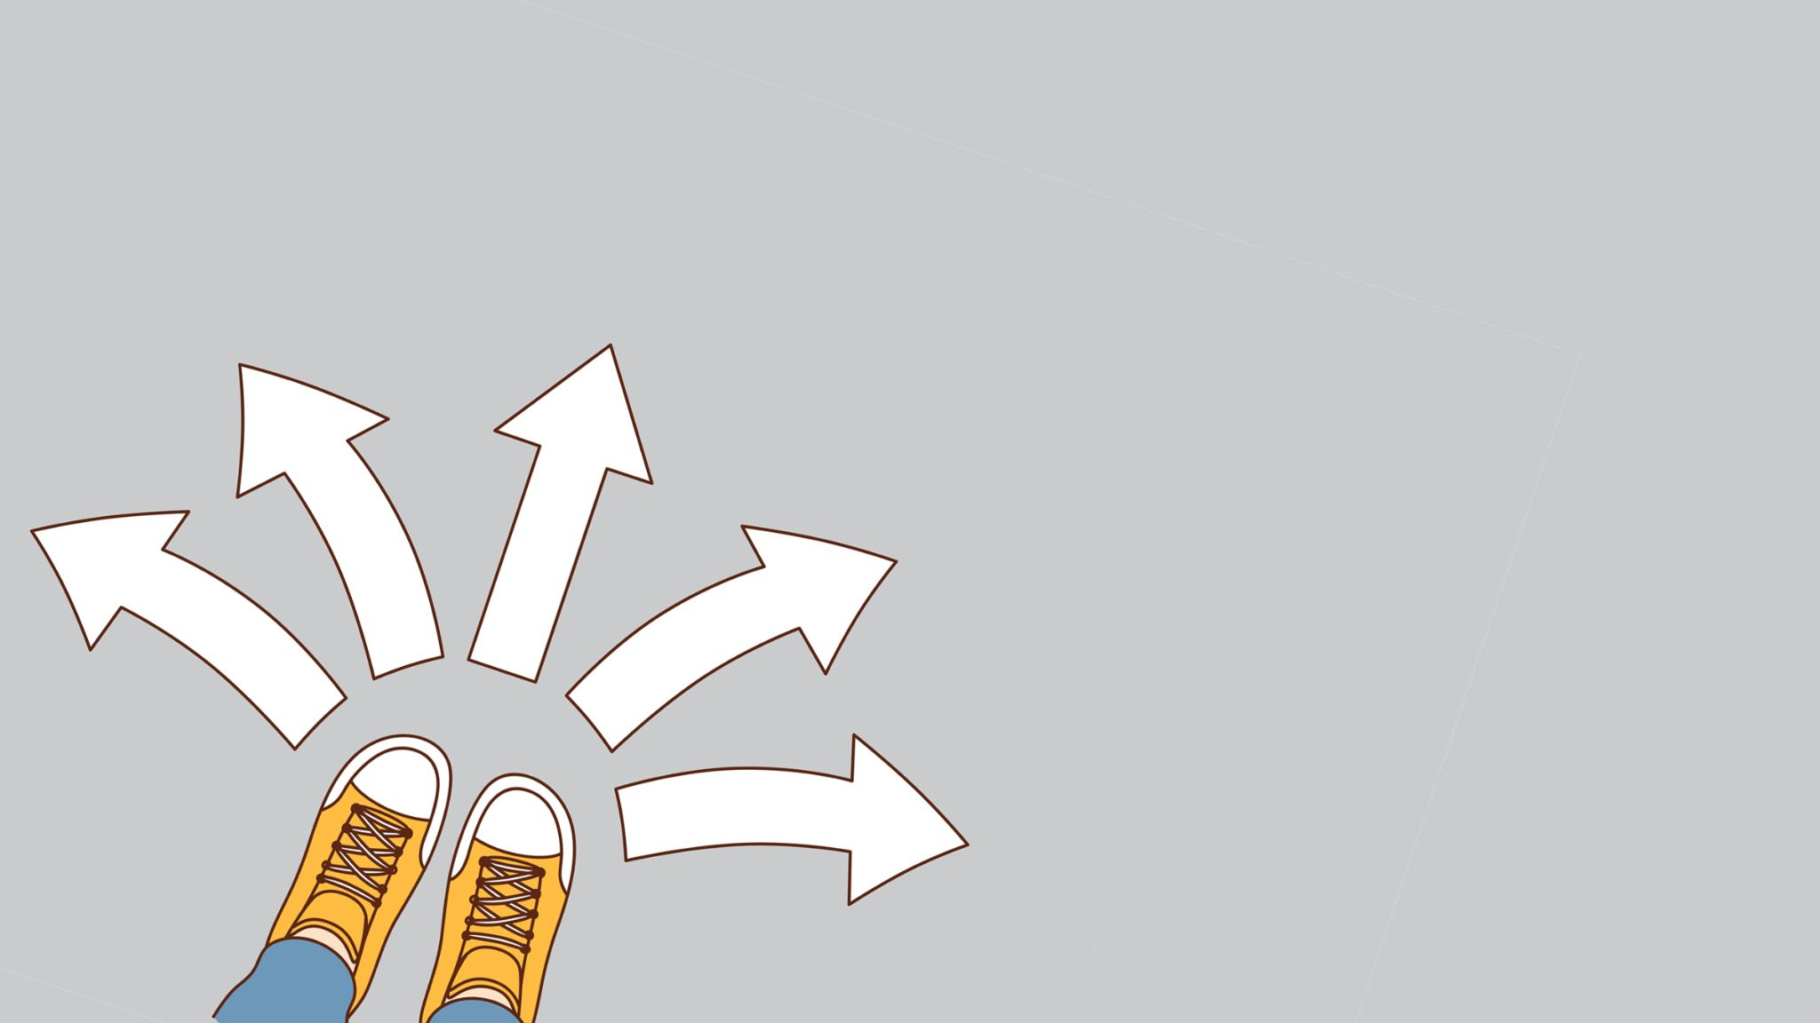
How do we do Teshuvah?
What do do we do when we realize we did something wrong?

Slide 8
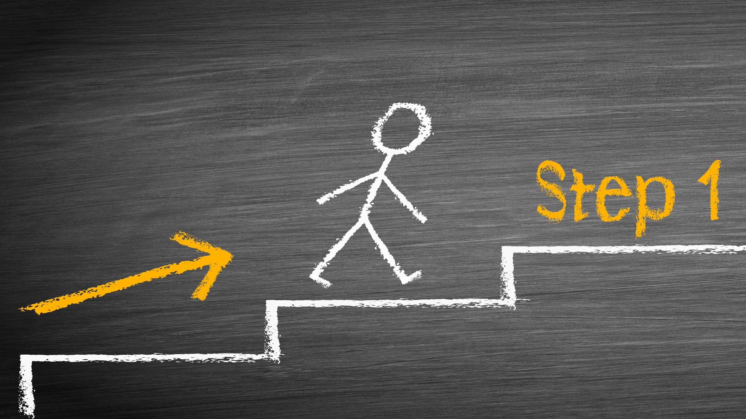
Step 1 = Regret
Regret
When doing something wrong, in order to make it better, we have to feel bad for doing it.

Slide 9
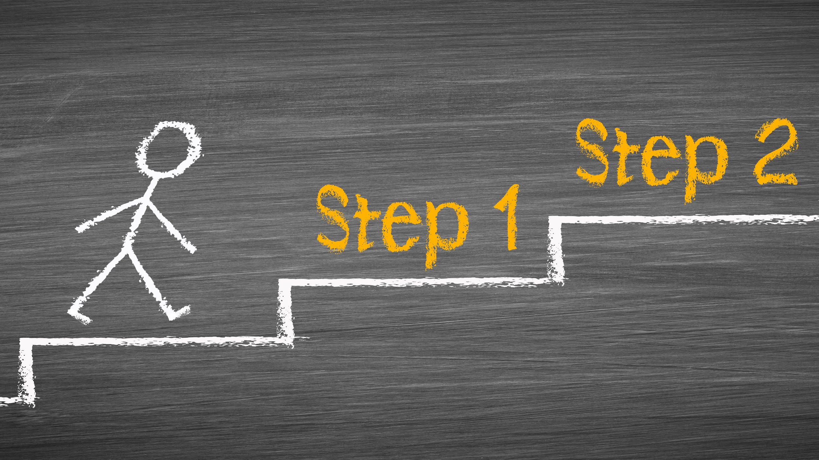
Step 2 = Admit
Admit
Regret
After we “Regret” - feel bad for what we did, we need to “Admit”, to say that we did something wrong.

Slide 10
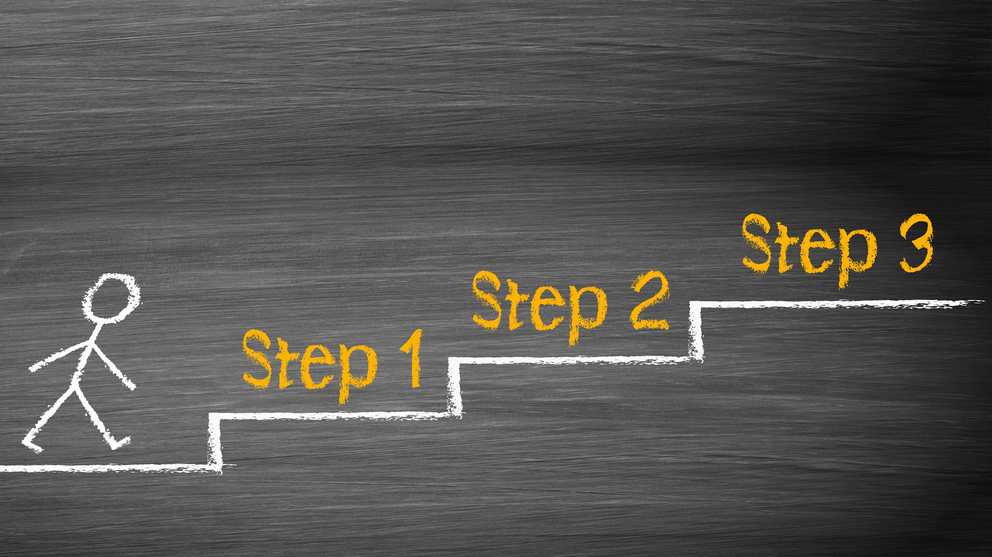
Step 3 = Decide
Decide
Admit
Regret
After we FEEL bad and SAY we did something wrong, we need to decide that it won’t happen again.

Slide 11
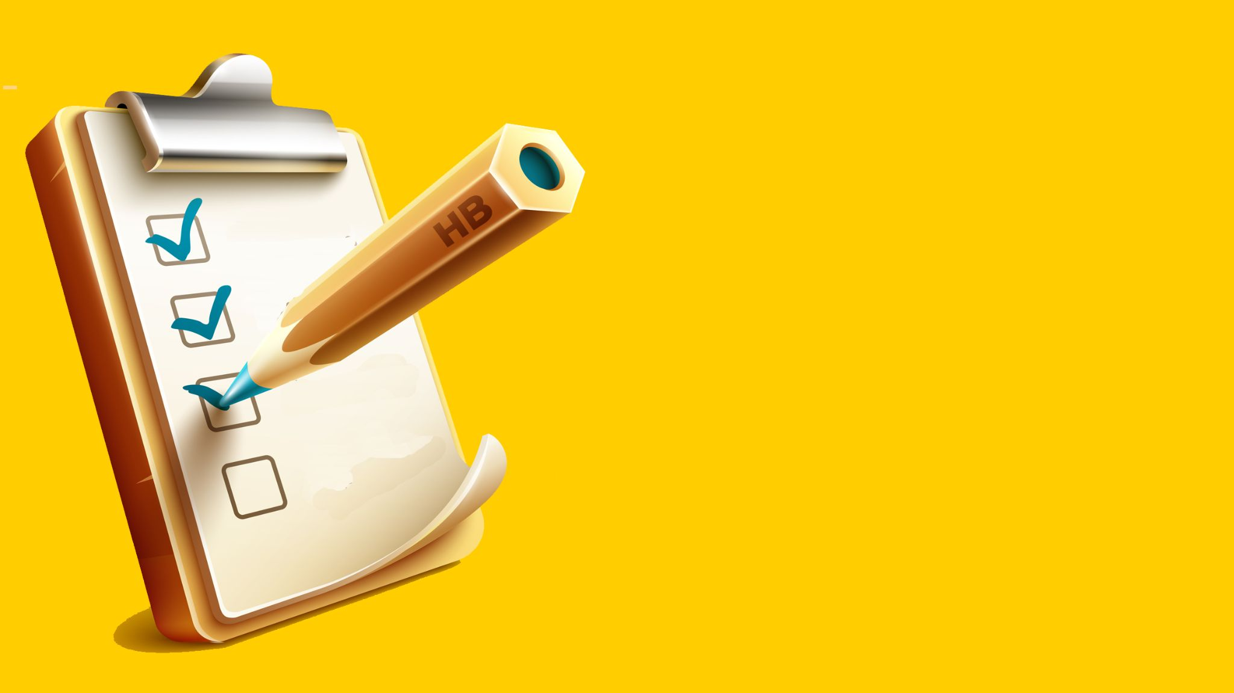
How do we celebrate Yom Kippur?
Are there things we don’t do on this day?

Slide 12
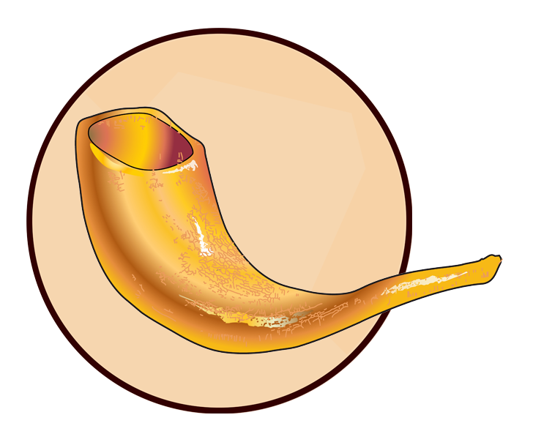
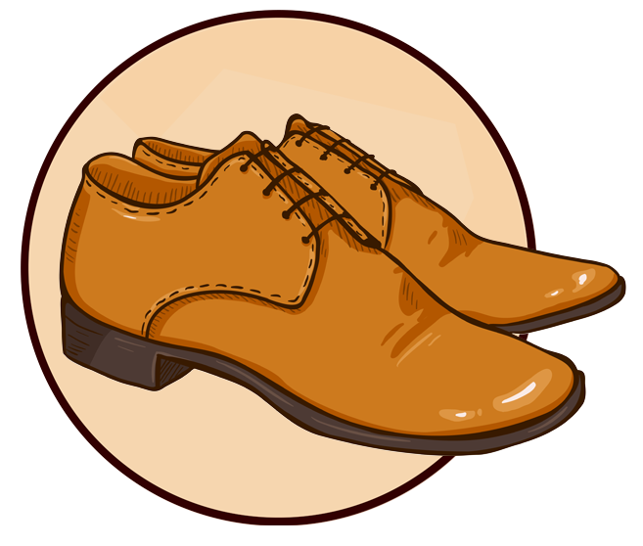
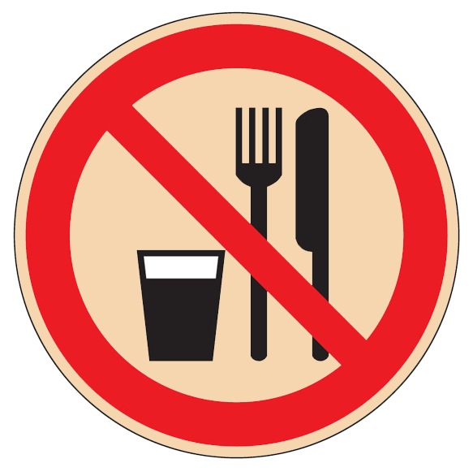
Shofar
Prayer
Shoes
Food

